Slide 1
INTRODUCTION TO STATISTICS
LECTURE 13

Slide 2
LAST TIME
Statistical tests
Parametric tests
Non-parametric tests
Practice in Python
Two random variables:
Covariance
Correlation

Slide 3
TODAY
Linear regression
Recap

Slide 4
LOGISTICS
Assignment 4 (part 2) was due yesterday
You can still submit
Assignment 5
Part 1 – published yesterday, due Friday, December 17, 23:59.
Part 1 – will be published today, due Saturday, December 18, 23:59.
Final exam
Tomorrow, Friday, December 18, 09:00 – 12:30
Available on Google Classroom (same as the mid-term)

Slide 5
LOGISTICS
Assignment 4 (part 2) was due yesterday
You can still submit
Assignment 5
Part 1 – published yesterday, due Friday, December 17, 23:59.
Part 1 – will be published today, due Saturday, December 18, 23:59.
Final exam
Tomorrow, Friday, December 18, 09:00 – 12:30
Available on Google Classroom (same as the mid-term)

Slide 6
LOGISTICS
Assignment 4 (part 2) was due yesterday
You can still submit
Assignment 5
Part 1 – published yesterday, due Friday, December 17, 23:59.
Part 1 – will be published today, due Saturday, December 18, 23:59.
Final exam
Tomorrow, Friday, December 18, 09:00 – 12:30
Available on Google Classroom (same as the mid-term)

Slide 7
LINEAR REGRESSION

Slide 8
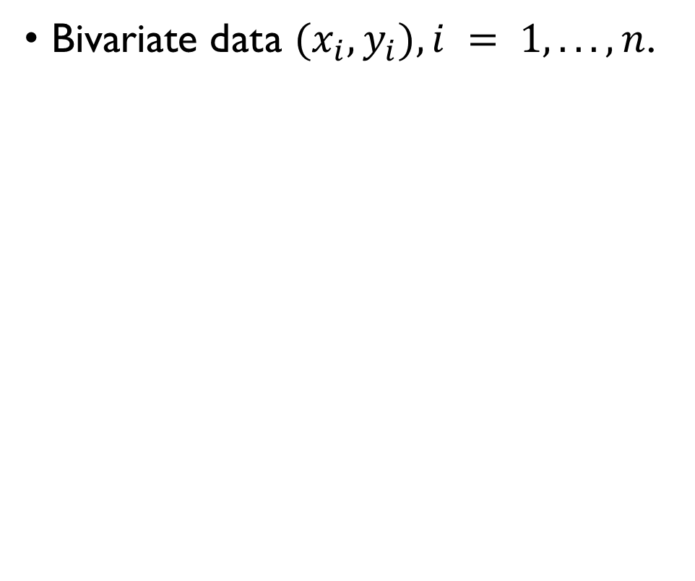
REGRESSION
Bivariate data $(x_{i}, y_{i}), i = 1, . . . , n$.
The goal: model the relationship between $x$ and $y$ as $y = f(x)$that is a close fit to the data.
Assumptions:
$x_{i}$ is not random - predictor
$y_{i},$is a function of xi plus some random noise - response

Slide 9
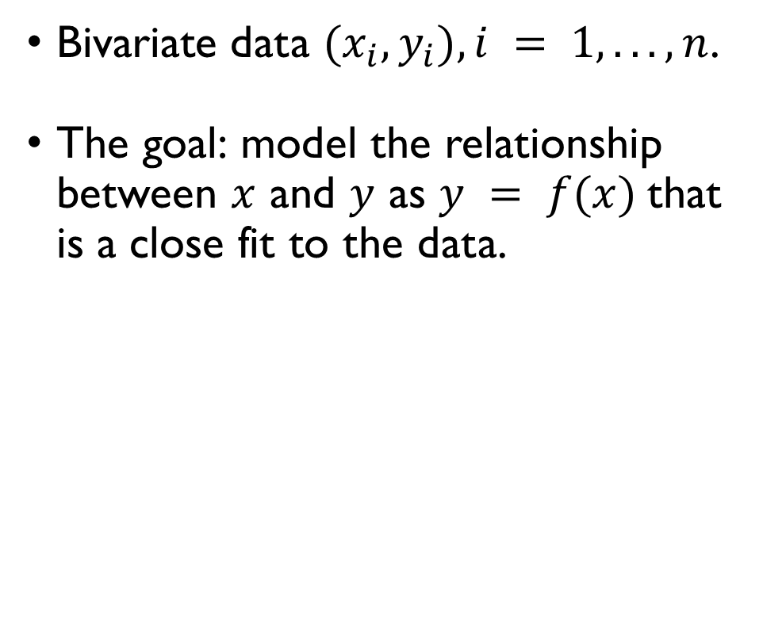
REGRESSION
Bivariate data $(x_{i}, y_{i}), i = 1, . . . , n$.
The goal: model the relationship between $x$ and $y$ as $y = f(x)$that is a close fit to the data.
Assumptions:
$x_{i}$ is not random - predictor
$y_{i},$is a function of xi plus some random noise - response

Slide 10
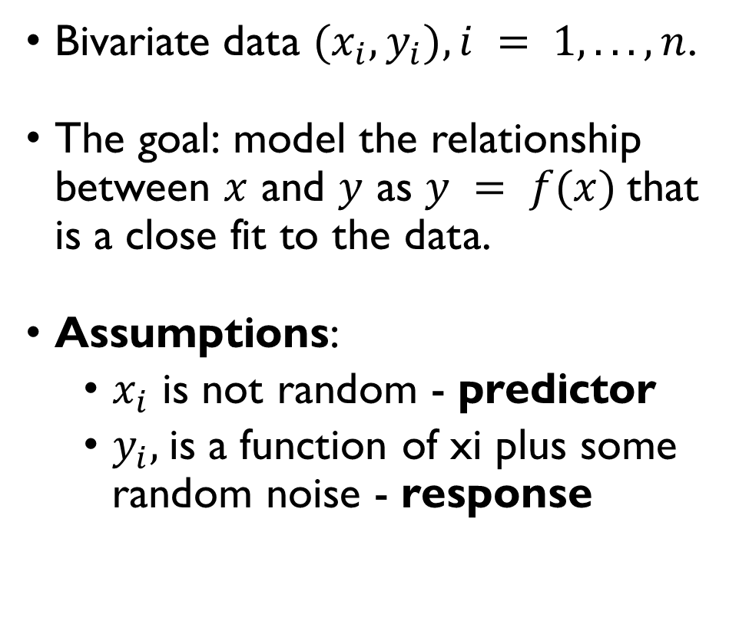
REGRESSION
Bivariate data $(x_{i}, y_{i}), i = 1, . . . , n$.
The goal: model the relationship between $x$ and $y$ as $y = f(x)$that is a close fit to the data.
Assumptions:
$x_{i}$ is not random - predictor
$y_{i},$is a function of xi plus some random noise - response

Slide 11
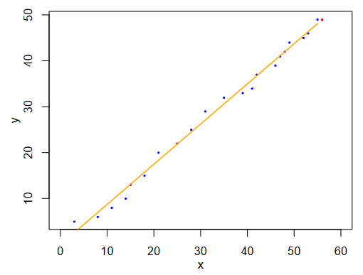
REGRESSION
Bivariate data $(x_{i}, y_{i}), i = 1, . . . , n$.
The goal: model the relationship between $x$ and $y$ as $y = f(x)$that is a close fit to the data.
Assumptions:
$x_{i}$ is not random - predictor
$y_{i},$is a function of xi plus some random noise - response
Time
Price of post stamps

Slide 12
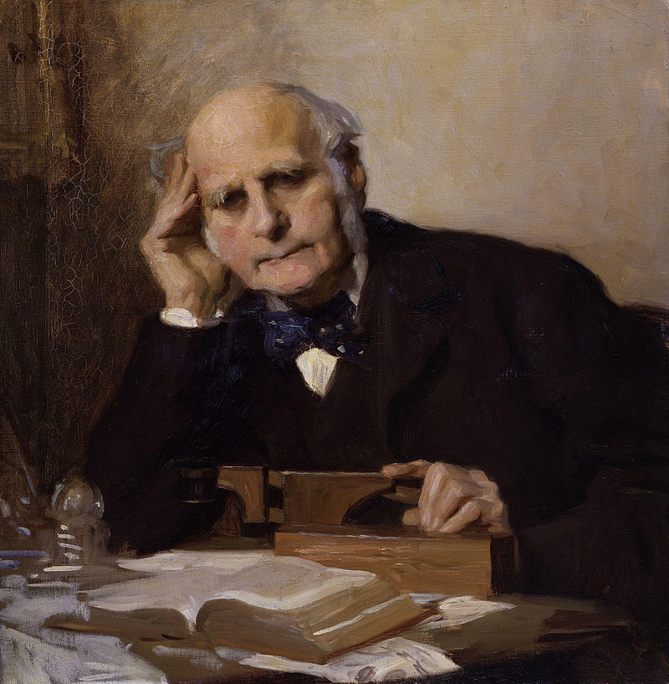
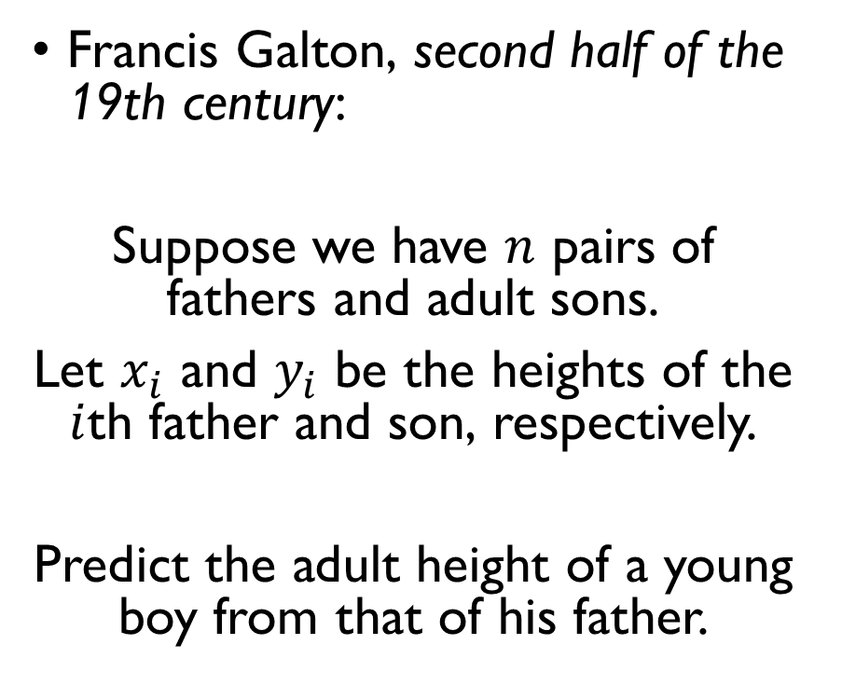
EXAMPLE
Francis Galton, second half of the 19th century:
Suppose we have $n$ pairs of fathers and adult sons.
Let $x_{i}$ and $y_{i}$ be the heights of the $i$th father and son, respectively.
Predict the adult height of a young boy from that of his father.

Slide 13
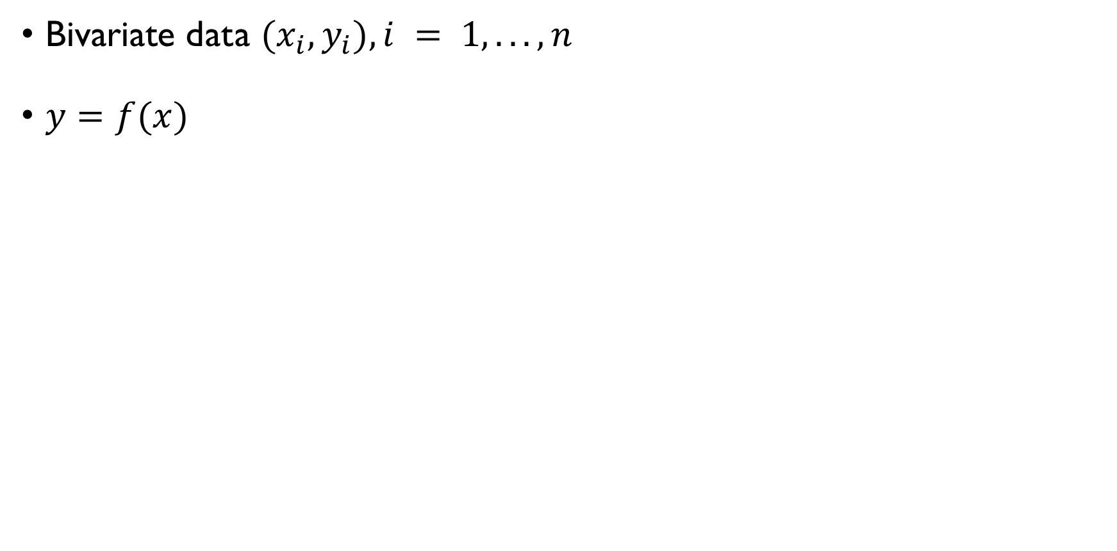
SIMPLE LINEAR REGRESSION
Bivariate data $(x_{i}, y_{i}), i = 1, . . . , n$
$y=f(x)$
Linear $f$: $y=ax+b$
Our model will predict $y_{i}$ up till some error $ε_{i}$:
$$y_{i}=ax_{i}+b+ε_{i}, ε_{i}\sim N\left(0,σ^{2}\right)$$
How to chose $a$ and $b$?

Slide 14
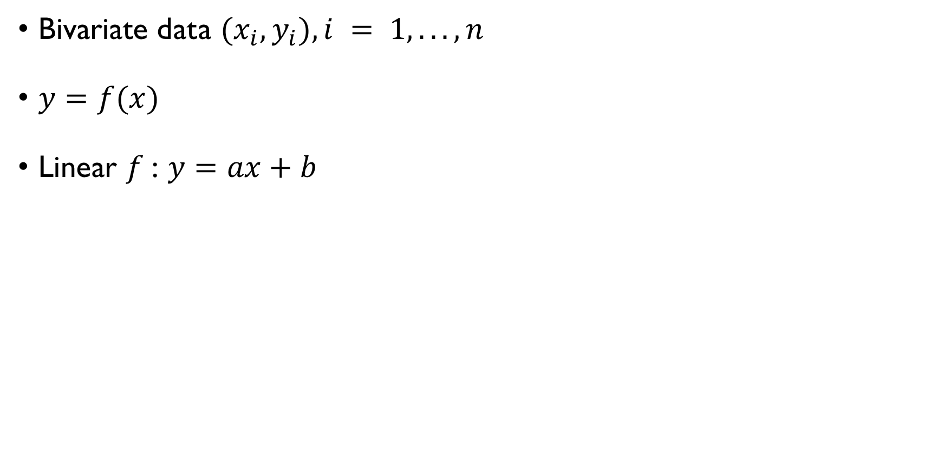
SIMPLE LINEAR REGRESSION
Bivariate data $(x_{i}, y_{i}), i = 1, . . . , n$
$y=f(x)$
Linear $f$: $y=ax+b$
Our model will predict $y_{i}$ up till some error $ε_{i}$:
$$y_{i}=ax_{i}+b+ε_{i}, ε_{i}\sim N\left(0,σ^{2}\right)$$
How to chose $a$ and $b$?

Slide 15
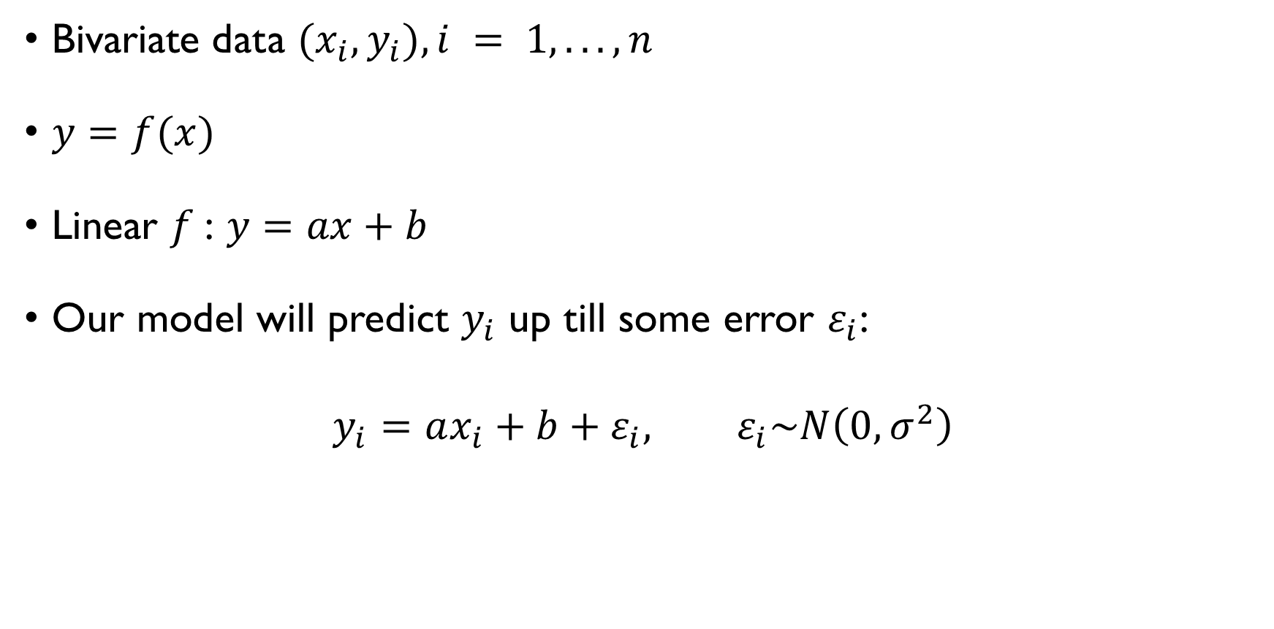
SIMPLE LINEAR REGRESSION
Bivariate data $(x_{i}, y_{i}), i = 1, . . . , n$
$y=f(x)$
Linear $f$: $y=ax+b$
Our model will predict $y_{i}$ up till some error $ε_{i}$:
$$y_{i}=ax_{i}+b+ε_{i}, ε_{i}\sim N\left(0,σ^{2}\right)$$
How to chose $a$ and $b$?

Slide 16
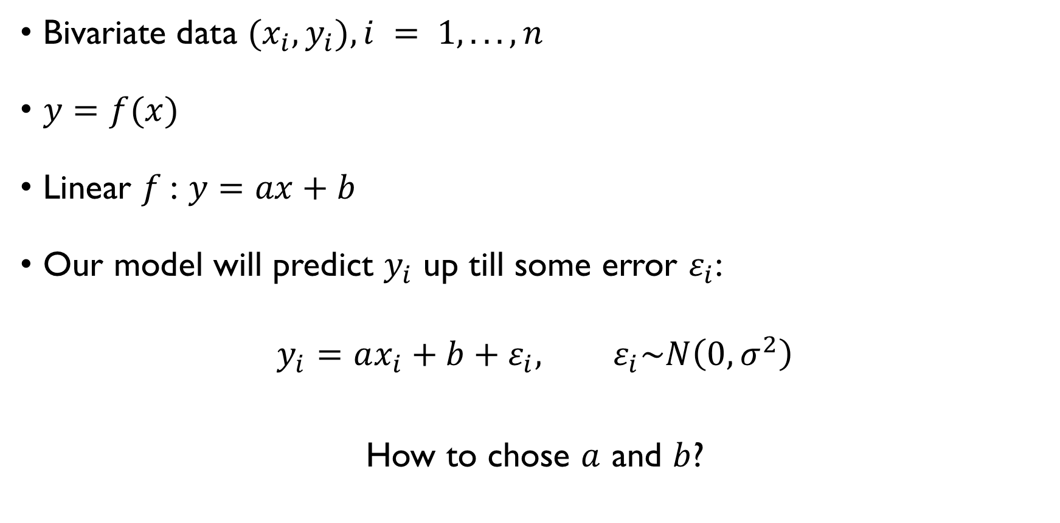
SIMPLE LINEAR REGRESSION
Bivariate data $(x_{i}, y_{i}), i = 1, . . . , n$
$y=f(x)$
Linear $f$: $y=ax+b$
Our model will predict $y_{i}$ up till some error $ε_{i}$:
$$y_{i}=ax_{i}+b+ε_{i}, ε_{i}\sim N\left(0,σ^{2}\right)$$
How to chose $a$ and $b$?

Slide 17
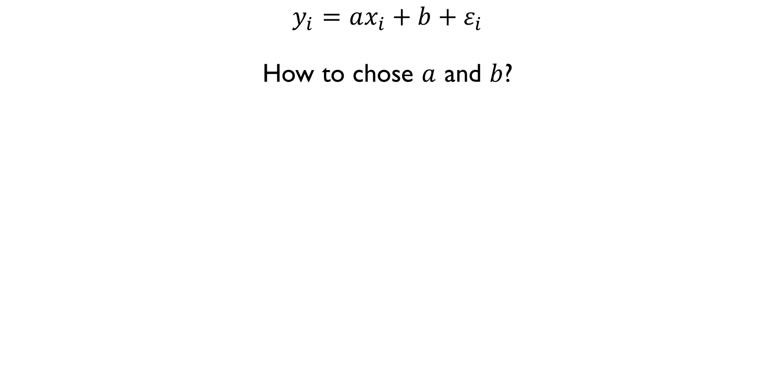
FINDING THE BEST FIT
$$y_{i}=ax_{i}+b+ε_{i}$$
How to chose $a$ and $b$?
$$ε_{i}=y_{i}−ax_{i}−b$$
$$ε_{i}^{2}={\left(y_{i}−ax_{i}−b\right)}^{2}$$
$$\sum_{i=1}^{n}{ε_{i}^{2}}=\sum_{i=1}^{n}{{\left(y_{i}−ax_{i}−b\right)}^{2}}→\min{w.r.t. a, b}$$

Slide 18
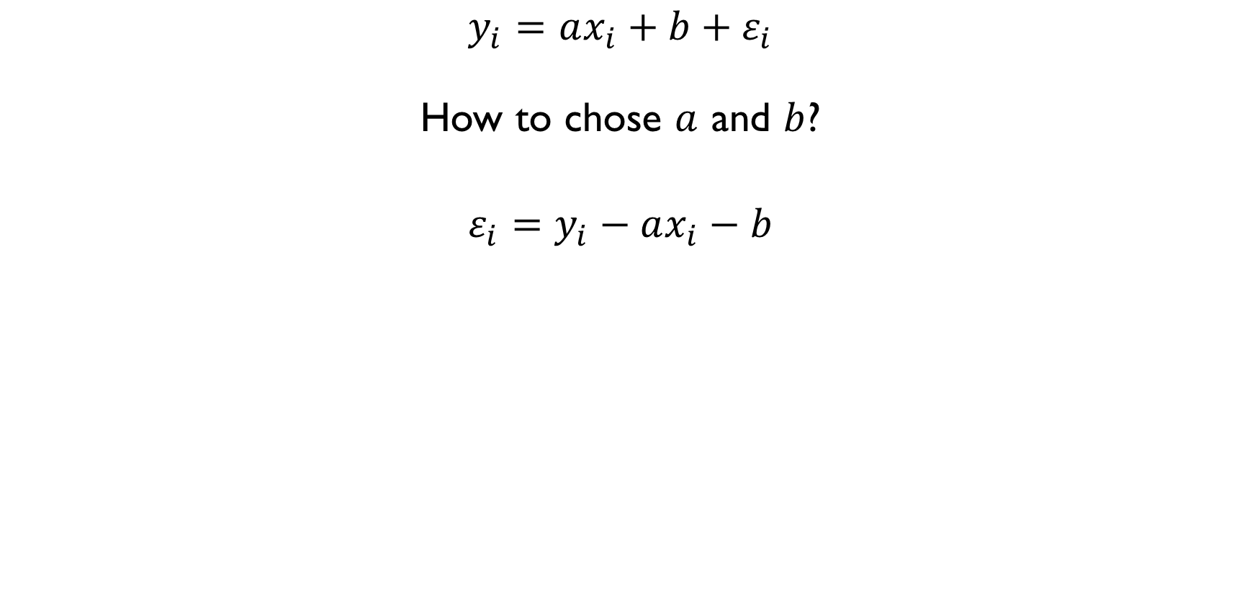
FINDING THE BEST FIT
$$y_{i}=ax_{i}+b+ε_{i}$$
How to chose $a$ and $b$?
$$ε_{i}=y_{i}−ax_{i}−b$$
$$ε_{i}^{2}={\left(y_{i}−ax_{i}−b\right)}^{2}$$
$$\sum_{i=1}^{n}{ε_{i}^{2}}=\sum_{i=1}^{n}{{\left(y_{i}−ax_{i}−b\right)}^{2}}→\min{w.r.t. a, b}$$

Slide 19
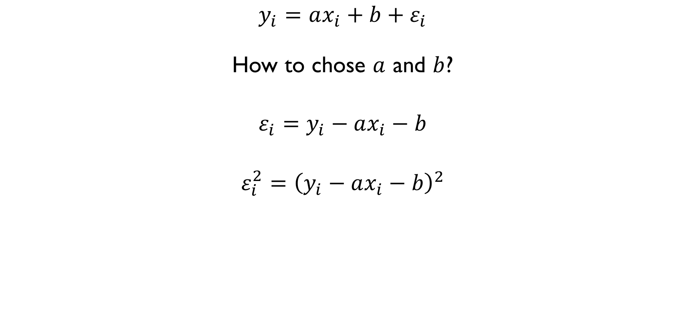
FINDING THE BEST FIT
$$y_{i}=ax_{i}+b+ε_{i}$$
How to chose $a$ and $b$?
$$ε_{i}=y_{i}−ax_{i}−b$$
$$ε_{i}^{2}={\left(y_{i}−ax_{i}−b\right)}^{2}$$
$$\sum_{i=1}^{n}{ε_{i}^{2}}=\sum_{i=1}^{n}{{\left(y_{i}−ax_{i}−b\right)}^{2}}→\min{w.r.t. a, b}$$

Slide 20
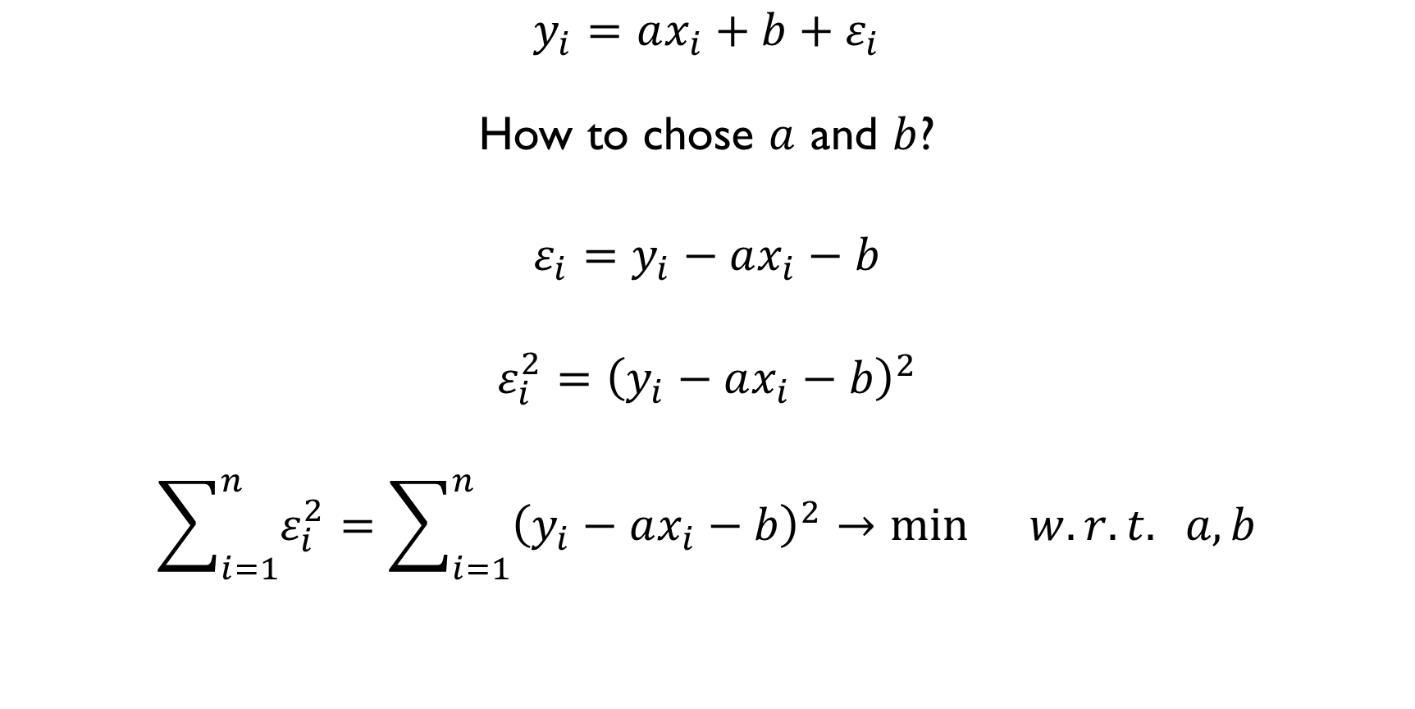
FINDING THE BEST FIT
$$y_{i}=ax_{i}+b+ε_{i}$$
How to chose $a$ and $b$?
$$ε_{i}=y_{i}−ax_{i}−b$$
$$ε_{i}^{2}={\left(y_{i}−ax_{i}−b\right)}^{2}$$
$$\sum_{i=1}^{n}{ε_{i}^{2}}=\sum_{i=1}^{n}{{\left(y_{i}−ax_{i}−b\right)}^{2}}→\min{w.r.t. a, b}$$
METHOD OF LEAST SQUARES

Slide 21
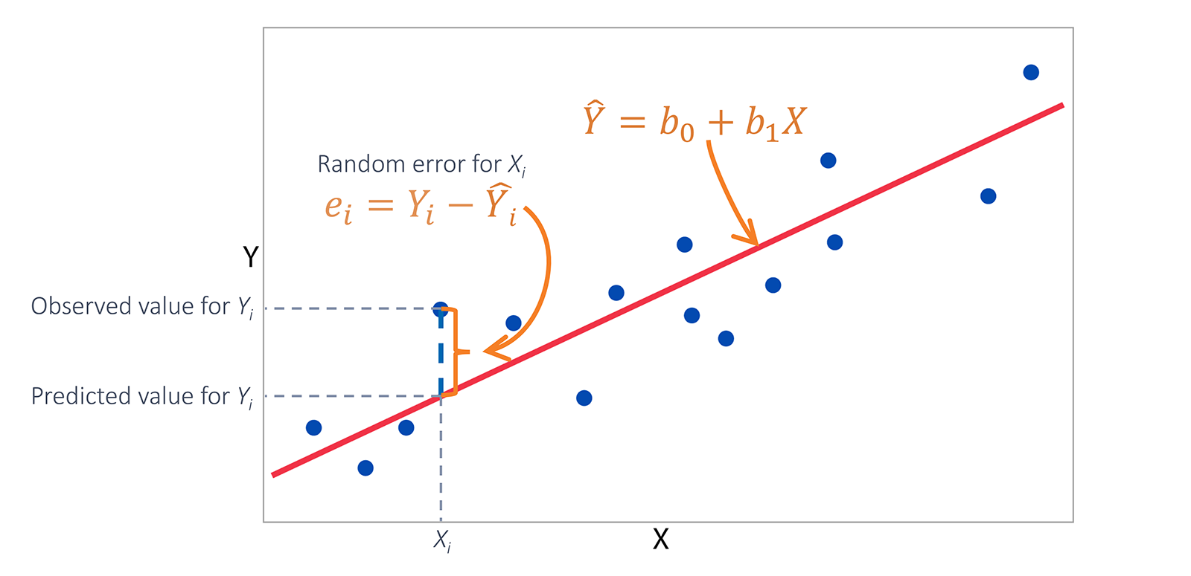

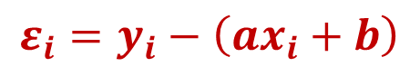
FINDING THE BEST FIT
$$\hat{y}=ax+b$$
$$ε_{i}=y_{i}−\left(ax_{i}+b\right)$$

Slide 22
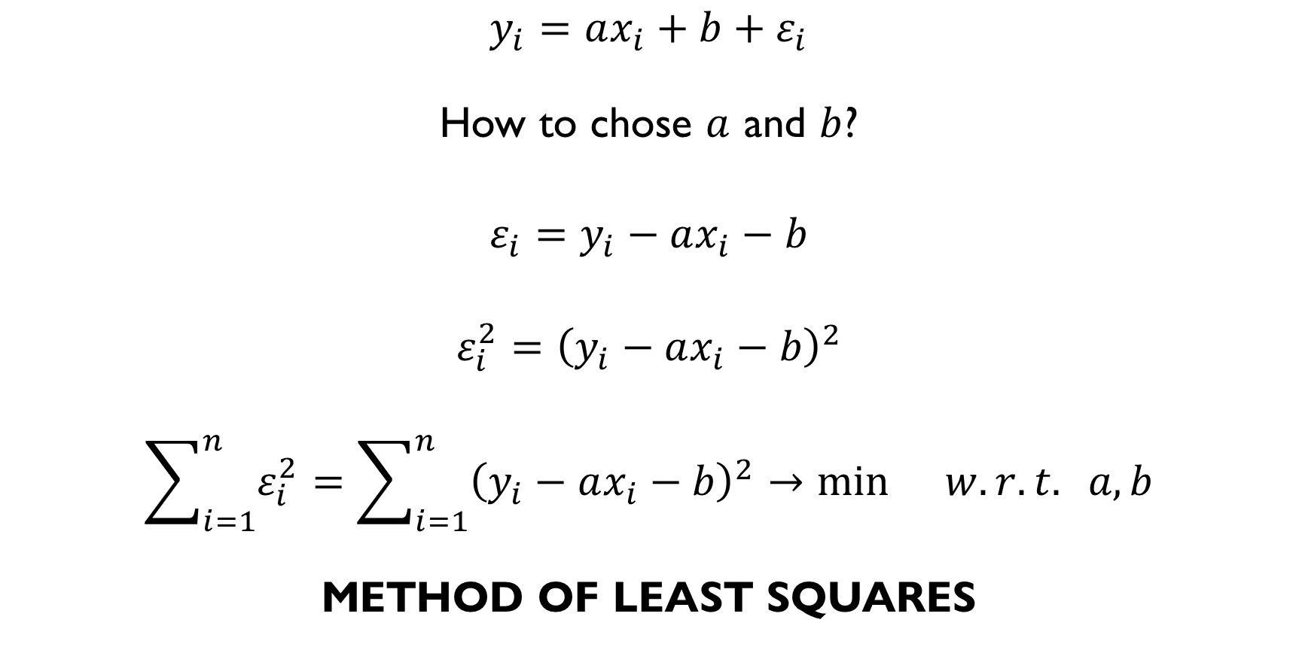
FINDING THE BEST FIT
$$y_{i}=ax_{i}+b+ε_{i}$$
How to chose $a$ and $b$?
$$ε_{i}=y_{i}−ax_{i}−b$$
$$ε_{i}^{2}={\left(y_{i}−ax_{i}−b\right)}^{2}$$
$$\sum_{i=1}^{n}{ε_{i}^{2}}=\sum_{i=1}^{n}{{\left(y_{i}−ax_{i}−b\right)}^{2}}→\min{w.r.t. a, b}$$
METHOD OF LEAST SQUARES

Slide 23
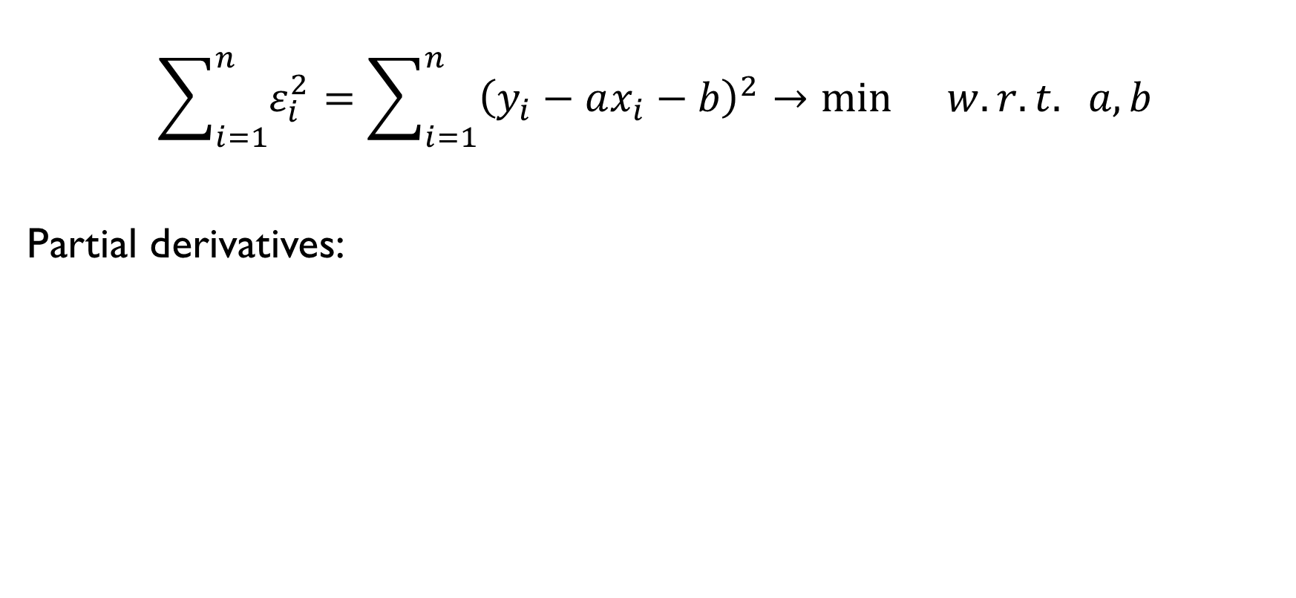
FINDING THE BEST FIT
$$\sum_{i=1}^{n}{ε_{i}^{2}}=\sum_{i=1}^{n}{{\left(y_{i}−ax_{i}−b\right)}^{2}}→\min{w.r.t. a, b}$$
Partial derivatives:
$$−2\sum_{i=1}^{n}{x_{i}\left(y_{i}−ax_{i}−b\right)}=0$$
$$−2\sum_{i=1}^{n}{\left(y_{i}−ax_{i}−b\right)}=0$$

Slide 24
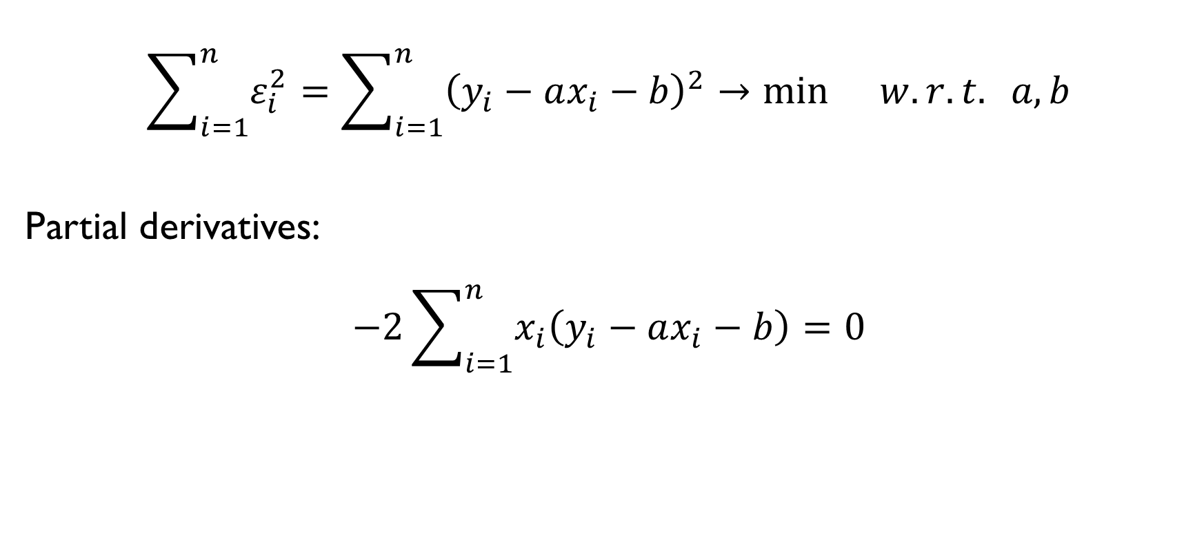
FINDING THE BEST FIT
$$\sum_{i=1}^{n}{ε_{i}^{2}}=\sum_{i=1}^{n}{{\left(y_{i}−ax_{i}−b\right)}^{2}}→\min{w.r.t. a, b}$$
Partial derivatives:
$$−2\sum_{i=1}^{n}{x_{i}\left(y_{i}−ax_{i}−b\right)}=0$$
$$−2\sum_{i=1}^{n}{\left(y_{i}−ax_{i}−b\right)}=0$$

Slide 25
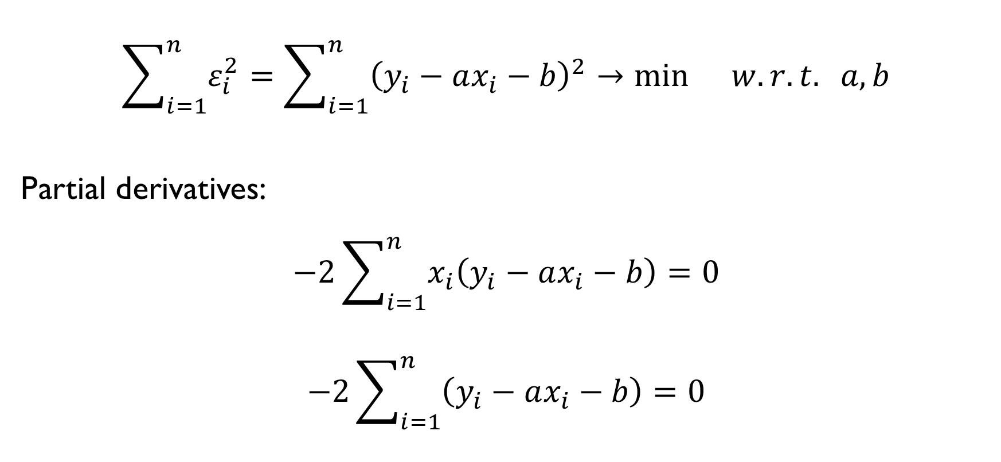
FINDING THE BEST FIT
$$\sum_{i=1}^{n}{ε_{i}^{2}}=\sum_{i=1}^{n}{{\left(y_{i}−ax_{i}−b\right)}^{2}}→\min{w.r.t. a, b}$$
Partial derivatives:
$$−2\sum_{i=1}^{n}{x_{i}\left(y_{i}−ax_{i}−b\right)}=0$$
$$−2\sum_{i=1}^{n}{\left(y_{i}−ax_{i}−b\right)}=0$$

Slide 26
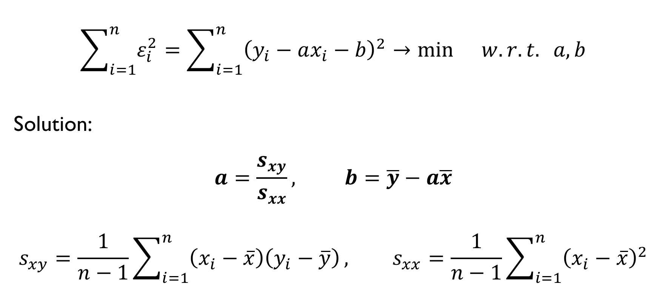
FINDING THE BEST FIT
$$\sum_{i=1}^{n}{ε_{i}^{2}}=\sum_{i=1}^{n}{{\left(y_{i}−ax_{i}−b\right)}^{2}}→\min{w.r.t. a, b}$$
Solution:
$$a=\frac{s_{xy}}{s_{xx}}, b=\overline{y}−a\overline{x}$$
$$s_{xy}=\frac{1}{n−1}\sum_{i=1}^{n}{\left(x_{i}−\overline{x}\right)\left(y_{i}−\overline{y}\right)}, s_{xx}=\frac{1}{n−1}\sum_{i=1}^{n}{{\left(x_{i}−\overline{x}\right)}^{2}}$$

Slide 27
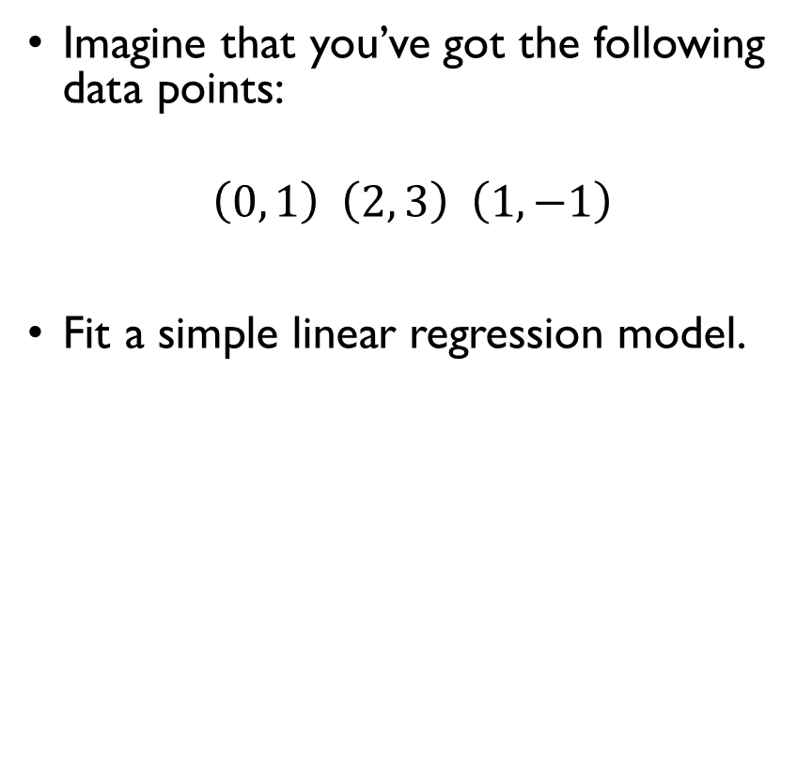
MAKE IT FIT
Imagine that you’ve got the following data points:
$$\left(0, 1\right) \left(2, 3\right) \left(1,−1\right)$$
Fit a simple linear regression model.
$$a=\frac{s_{xy}}{s_{xx}}, b=\overline{y}−a\overline{x}$$
$$s_{xy}=\frac{1}{n−1}\sum_{i=1}^{n}{\left(x_{i}−\overline{x}\right)\left(y_{i}−\overline{y}\right)}$$
$$s_{xx}=\frac{1}{n−1}\sum_{i=1}^{n}{{\left(x_{i}−\overline{x}\right)}^{2}}$$

Slide 28
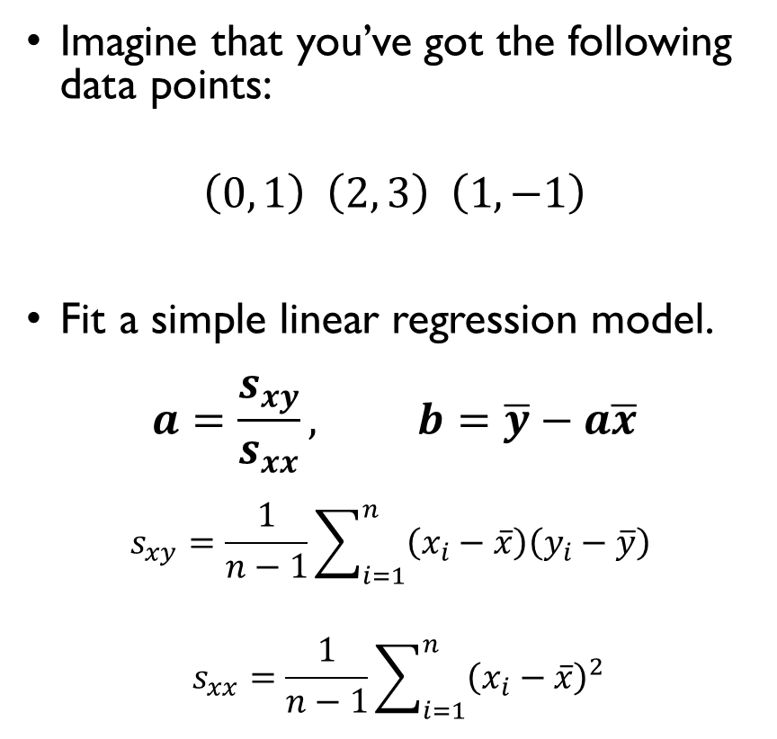
MAKE IT FIT
Imagine that you’ve got the following data points:
$$\left(0, 1\right) \left(2, 3\right) \left(1,−1\right)$$
Fit a simple linear regression model.
$$a=\frac{s_{xy}}{s_{xx}}, b=\overline{y}−a\overline{x}$$
$$s_{xy}=\frac{1}{n−1}\sum_{i=1}^{n}{\left(x_{i}−\overline{x}\right)\left(y_{i}−\overline{y}\right)}$$
$$s_{xx}=\frac{1}{n−1}\sum_{i=1}^{n}{{\left(x_{i}−\overline{x}\right)}^{2}}$$

Slide 29
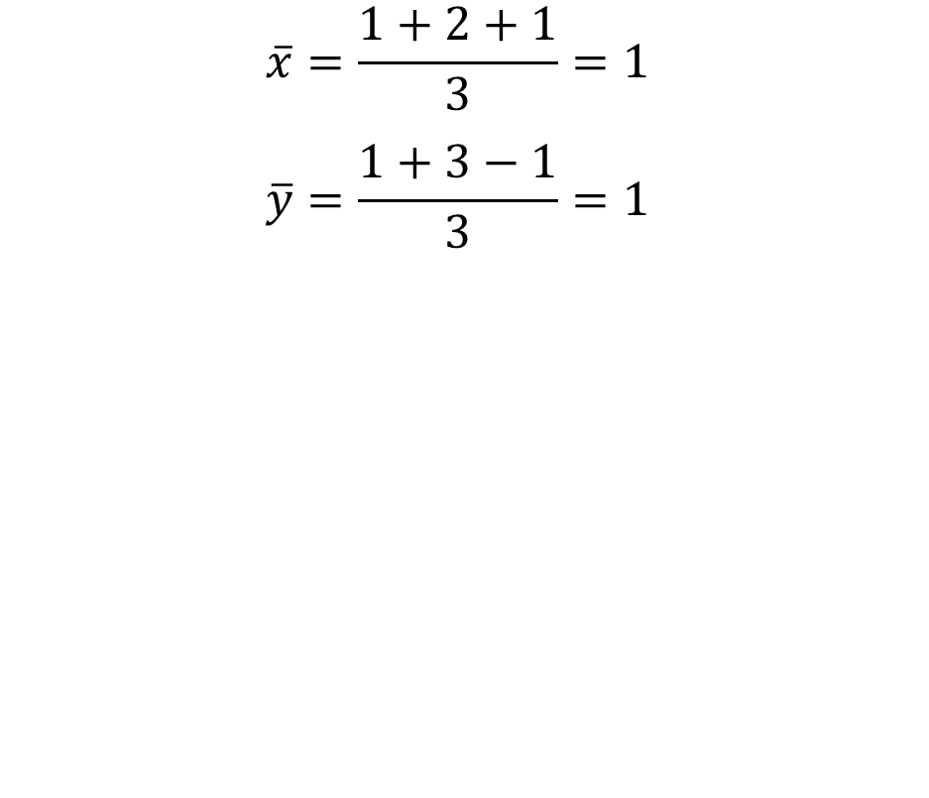
MAKE IT FIT
Imagine that you’ve got the following data points:
$$\left(0, 1\right) \left(2, 3\right) \left(1,−1\right)$$
Fit a simple linear regression model.
$$a=\frac{s_{xy}}{s_{xx}}, b=\overline{y}−a\overline{x}$$
$$s_{xy}=\frac{1}{n−1}\sum_{i=1}^{n}{\left(x_{i}−\overline{x}\right)\left(y_{i}−\overline{y}\right)}$$
$$s_{xx}=\frac{1}{n−1}\sum_{i=1}^{n}{{\left(x_{i}−\overline{x}\right)}^{2}}$$
$$\overline{x}=\frac{1+2+1}{3}=1$$
$$\overline{y}=\frac{1+3−1}{3}=1$$
$$s_{xx}=\frac{{\left(0−1\right)}^{2}+{\left(2−1\right)}^{2}+{\left(1−1\right)}^{2}}{3−1}=1$$
$$s_{xy}=\frac{\left(−1\right)∙0+1∙2+0∙\left(−2\right)}{3−1}=1$$
$$a=\frac{1}{1}=1, b=1−1∙1=0$$
$$y=x$$

Slide 30
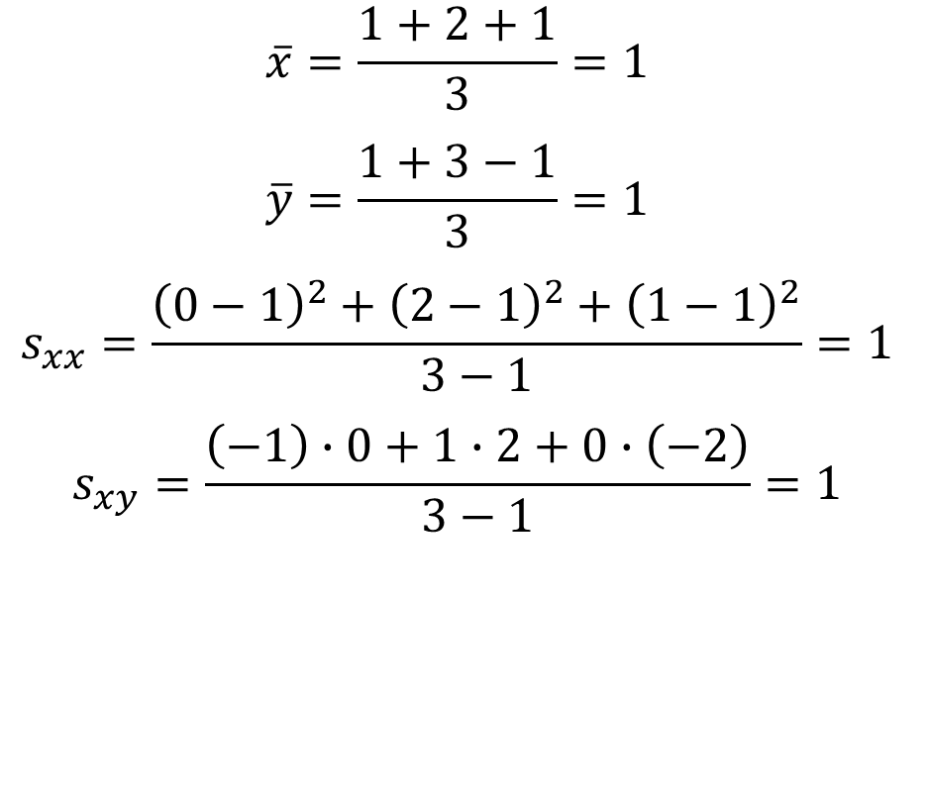
MAKE IT FIT
Imagine that you’ve got the following data points:
$$\left(0, 1\right) \left(2, 3\right) \left(1,−1\right)$$
Fit a simple linear regression model.
$$a=\frac{s_{xy}}{s_{xx}}, b=\overline{y}−a\overline{x}$$
$$s_{xy}=\frac{1}{n−1}\sum_{i=1}^{n}{\left(x_{i}−\overline{x}\right)\left(y_{i}−\overline{y}\right)}$$
$$s_{xx}=\frac{1}{n−1}\sum_{i=1}^{n}{{\left(x_{i}−\overline{x}\right)}^{2}}$$
$$\overline{x}=\frac{1+2+1}{3}=1$$
$$\overline{y}=\frac{1+3−1}{3}=1$$
$$s_{xx}=\frac{{\left(0−1\right)}^{2}+{\left(2−1\right)}^{2}+{\left(1−1\right)}^{2}}{3−1}=1$$
$$s_{xy}=\frac{\left(−1\right)∙0+1∙2+0∙\left(−2\right)}{3−1}=1$$
$$a=\frac{1}{1}=1, b=1−1∙1=0$$
$$y=x$$

Slide 31
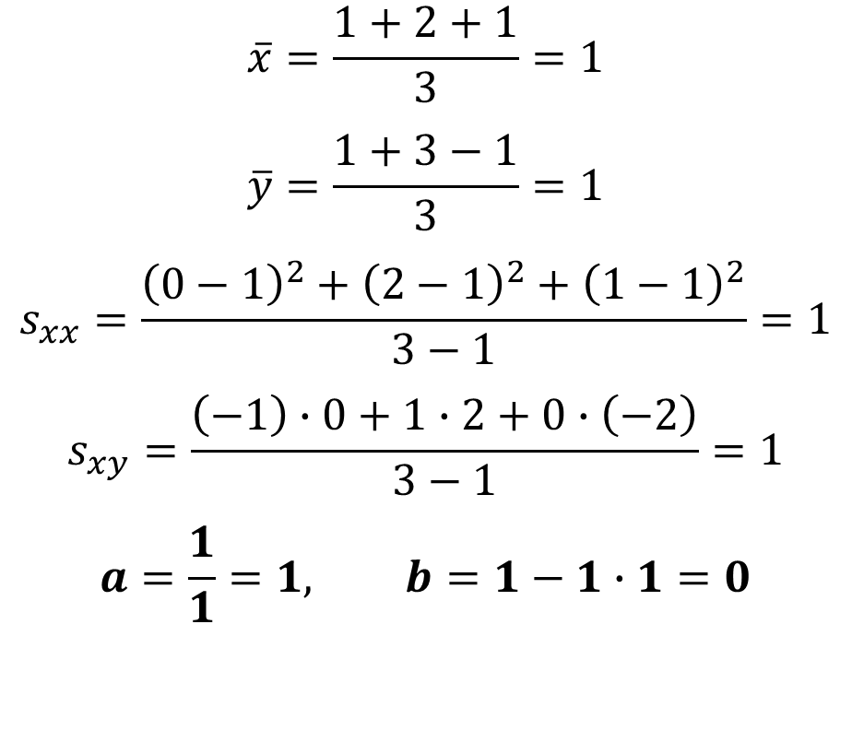
MAKE IT FIT
Imagine that you’ve got the following data points:
$$\left(0, 1\right) \left(2, 3\right) \left(1,−1\right)$$
Fit a simple linear regression model.
$$a=\frac{s_{xy}}{s_{xx}}, b=\overline{y}−a\overline{x}$$
$$s_{xy}=\frac{1}{n−1}\sum_{i=1}^{n}{\left(x_{i}−\overline{x}\right)\left(y_{i}−\overline{y}\right)}$$
$$s_{xx}=\frac{1}{n−1}\sum_{i=1}^{n}{{\left(x_{i}−\overline{x}\right)}^{2}}$$
$$\overline{x}=\frac{1+2+1}{3}=1$$
$$\overline{y}=\frac{1+3−1}{3}=1$$
$$s_{xx}=\frac{{\left(0−1\right)}^{2}+{\left(2−1\right)}^{2}+{\left(1−1\right)}^{2}}{3−1}=1$$
$$s_{xy}=\frac{\left(−1\right)∙0+1∙2+0∙\left(−2\right)}{3−1}=1$$
$$a=\frac{1}{1}=1, b=1−1∙1=0$$
$$y=x$$

Slide 32
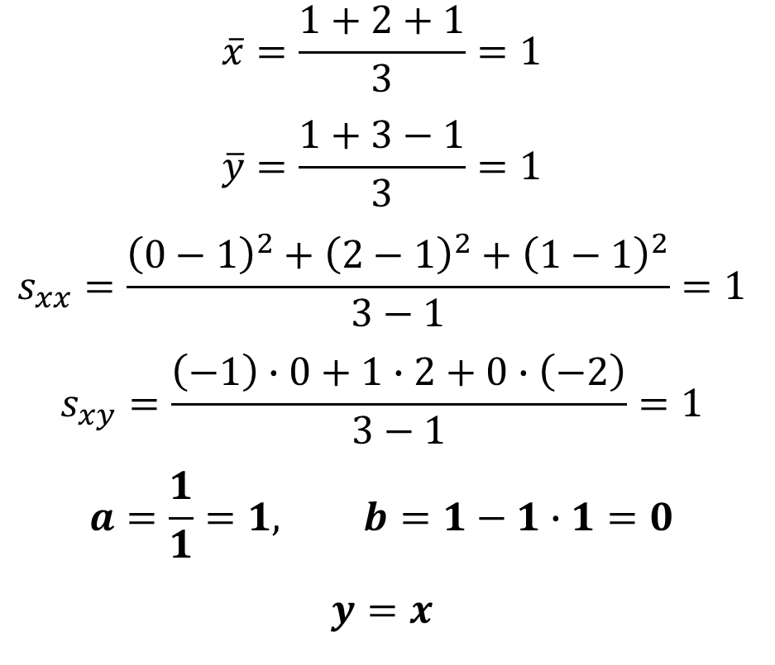
MAKE IT FIT
Imagine that you’ve got the following data points:
$$\left(0, 1\right) \left(2, 3\right) \left(1,−1\right)$$
Fit a simple linear regression model.
$$a=\frac{s_{xy}}{s_{xx}}, b=\overline{y}−a\overline{x}$$
$$s_{xy}=\frac{1}{n−1}\sum_{i=1}^{n}{\left(x_{i}−\overline{x}\right)\left(y_{i}−\overline{y}\right)}$$
$$s_{xx}=\frac{1}{n−1}\sum_{i=1}^{n}{{\left(x_{i}−\overline{x}\right)}^{2}}$$
$$\overline{x}=\frac{1+2+1}{3}=1$$
$$\overline{y}=\frac{1+3−1}{3}=1$$
$$s_{xx}=\frac{{\left(0−1\right)}^{2}+{\left(2−1\right)}^{2}+{\left(1−1\right)}^{2}}{3−1}=1$$
$$s_{xy}=\frac{\left(−1\right)∙0+1∙2+0∙\left(−2\right)}{3−1}=1$$
$$a=\frac{1}{1}=1, b=1−1∙1=0$$
$$y=x$$

Slide 33
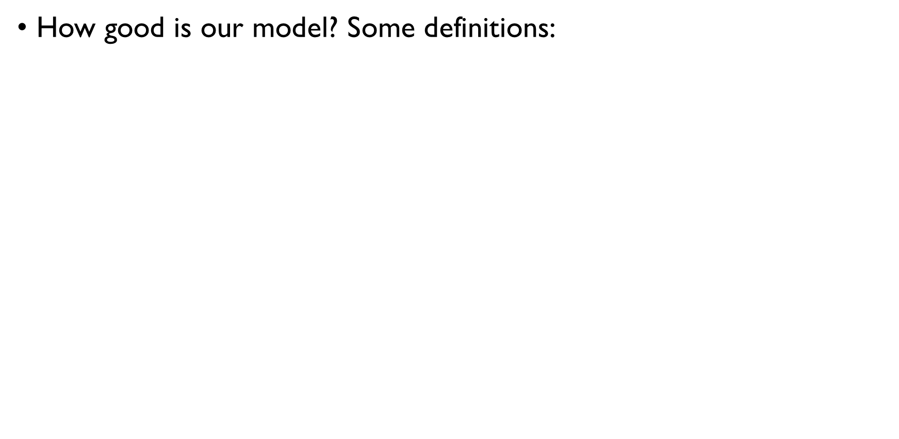
QUALITY OF THE FIT
How good is our model? Some definitions:
TOTAL Sum of Squares: how much variation in there in $y$?
$$SS_{tot}=\sum{{\left(y_{i}−\overline{y}\right)}^{2}}$$
MODEL Sum of Squares: how much of it the model explains?
$$SS_{mod}=\sum{{\left({\hat{y}}_{i}−\overline{y}\right)}^{2}}$$
RESIDUAL Sum of Squares: how much the model doesn’t explain?
$$SS_{res}=\sum{{\left(y_{i}−{\hat{y}}_{i}\right)}^{2}}=\sum{{\left(y_{i}−ax_{i}−b\right)}^{2}}$$

Slide 34
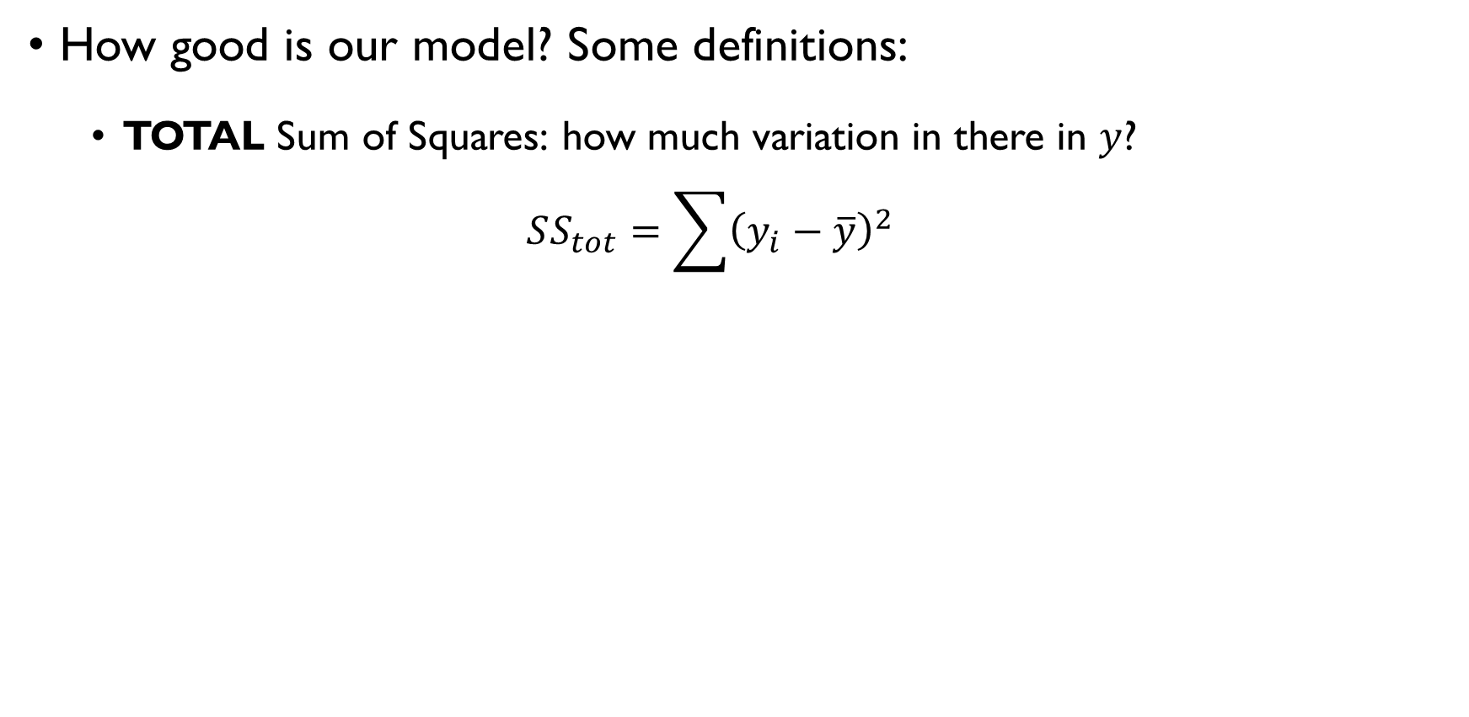
QUALITY OF THE FIT
How good is our model? Some definitions:
TOTAL Sum of Squares: how much variation in there in $y$?
$$SS_{tot}=\sum{{\left(y_{i}−\overline{y}\right)}^{2}}$$
MODEL Sum of Squares: how much of it the model explains?
$$SS_{mod}=\sum{{\left({\hat{y}}_{i}−\overline{y}\right)}^{2}}$$
RESIDUAL Sum of Squares: how much the model doesn’t explain?
$$SS_{res}=\sum{{\left(y_{i}−{\hat{y}}_{i}\right)}^{2}}=\sum{{\left(y_{i}−ax_{i}−b\right)}^{2}}$$

Slide 35
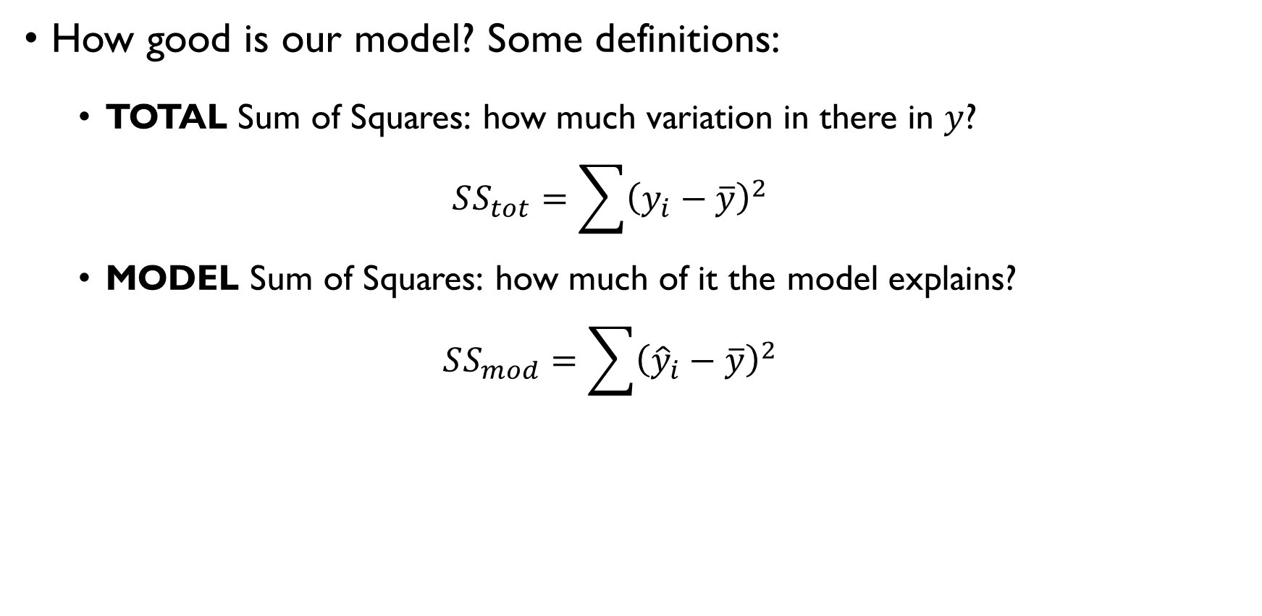
QUALITY OF THE FIT
How good is our model? Some definitions:
TOTAL Sum of Squares: how much variation in there in $y$?
$$SS_{tot}=\sum{{\left(y_{i}−\overline{y}\right)}^{2}}$$
MODEL Sum of Squares: how much of it the model explains?
$$SS_{mod}=\sum{{\left({\hat{y}}_{i}−\overline{y}\right)}^{2}}$$
RESIDUAL Sum of Squares: how much the model doesn’t explain?
$$SS_{res}=\sum{{\left(y_{i}−{\hat{y}}_{i}\right)}^{2}}=\sum{{\left(y_{i}−ax_{i}−b\right)}^{2}}$$

Slide 36
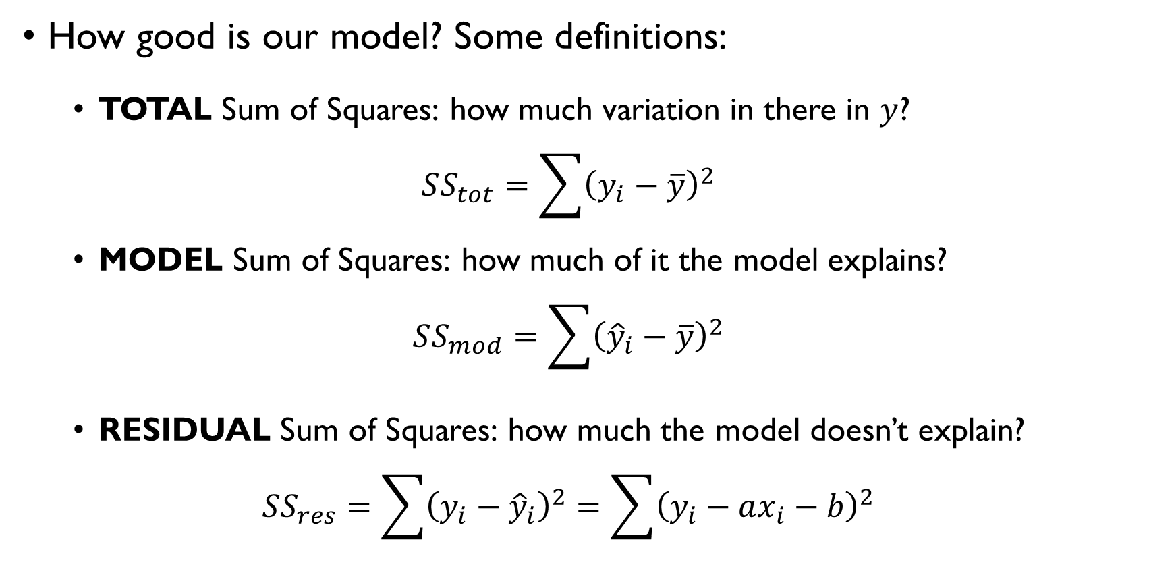
QUALITY OF THE FIT
How good is our model? Some definitions:
TOTAL Sum of Squares: how much variation in there in $y$?
$$SS_{tot}=\sum{{\left(y_{i}−\overline{y}\right)}^{2}}$$
MODEL Sum of Squares: how much of it the model explains?
$$SS_{mod}=\sum{{\left({\hat{y}}_{i}−\overline{y}\right)}^{2}}$$
RESIDUAL Sum of Squares: how much the model doesn’t explain?
$$SS_{res}=\sum{{\left(y_{i}−{\hat{y}}_{i}\right)}^{2}}=\sum{{\left(y_{i}−ax_{i}−b\right)}^{2}}$$

Slide 37
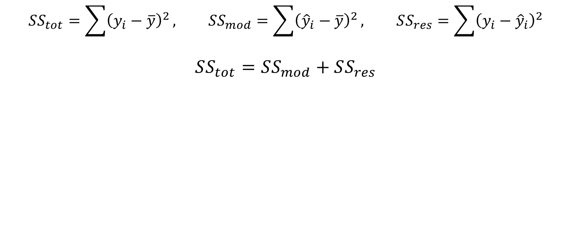
QUALITY OF THE FIT
$$SS_{tot}=\sum{{\left(y_{i}−\overline{y}\right)}^{2}}, SS_{mod}=\sum{{\left({\hat{y}}_{i}−\overline{y}\right)}^{2}}, SS_{res}=\sum{{\left(y_{i}−{\hat{y}}_{i}\right)}^{2}}$$
$$SS_{tot}=SS_{mod}+SS_{res}$$
Coefficient of determination: explained variation
$$R^{2}=1−\frac{SS_{res}}{SS_{tot}}=\frac{SS_{mod}}{SS_{tot}}$$

Slide 38
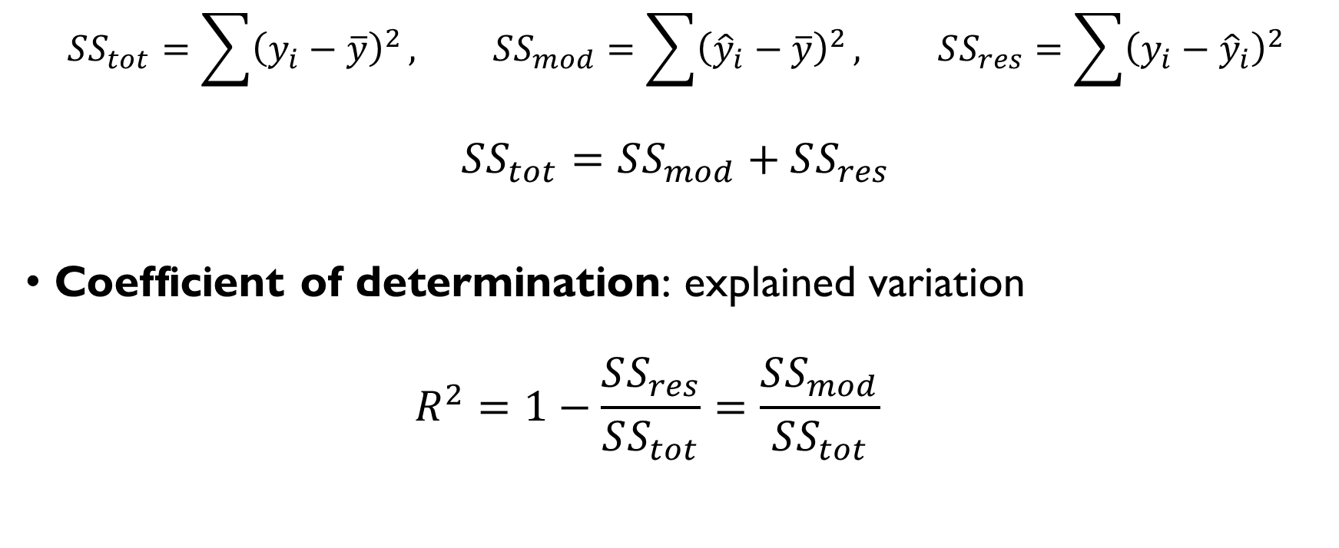
QUALITY OF THE FIT
$$SS_{tot}=\sum{{\left(y_{i}−\overline{y}\right)}^{2}}, SS_{mod}=\sum{{\left({\hat{y}}_{i}−\overline{y}\right)}^{2}}, SS_{res}=\sum{{\left(y_{i}−{\hat{y}}_{i}\right)}^{2}}$$
$$SS_{tot}=SS_{mod}+SS_{res}$$
Coefficient of determination: explained variation
$$R^{2}=1−\frac{SS_{res}}{SS_{tot}}=\frac{SS_{mod}}{SS_{tot}}$$

Slide 39
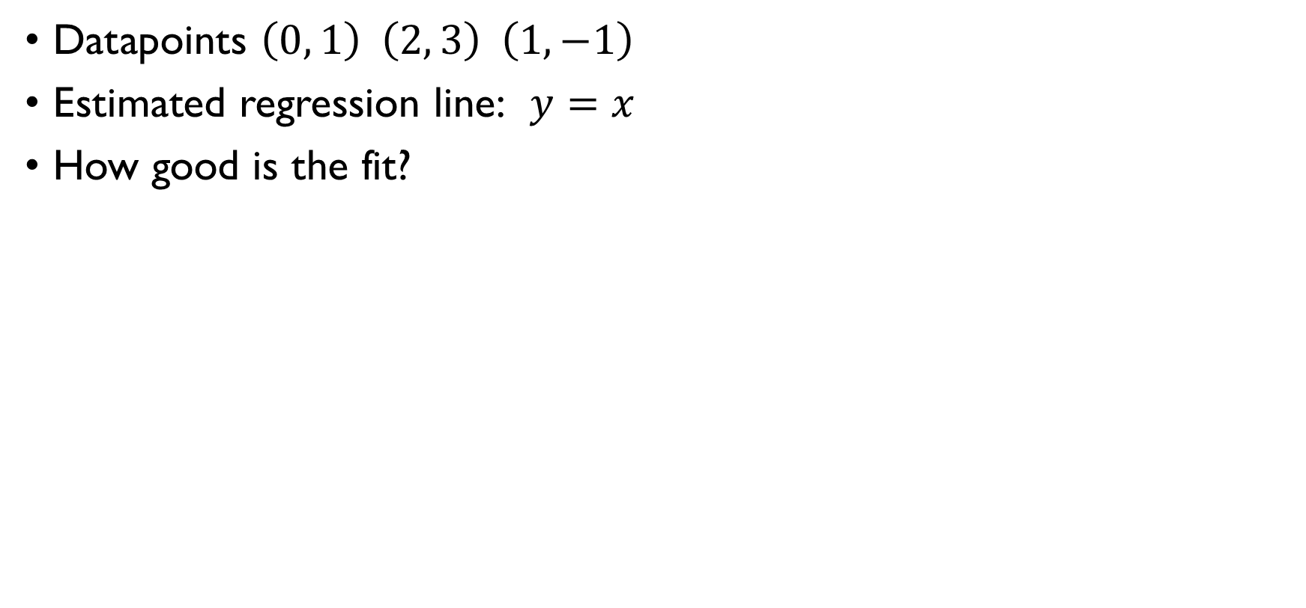
QUALITY OF THE FIT - EXAMPLE
Datapoints $\left(0, 1\right) \left(2, 3\right) \left(1,−1\right)$
Estimated regression line: $y=x$
How good is the fit?
$$R^{2}=1−\frac{SS_{res}}{SS_{tot}}=1−\frac{6}{8}=0.25$$
$$SS_{tot}=\frac{{\left(1−1\right)}^{2}+{\left(3−1\right)}^{2}+{\left(−1−1\right)}^{2}}{3}=\frac{8}{3}$$
$$SS_{res}=\frac{{\left(0−1\right)}^{2}+{\left(2−3\right)}^{2}+{\left(1+1\right)}^{2}}{3}=\frac{6}{3}$$

Slide 40
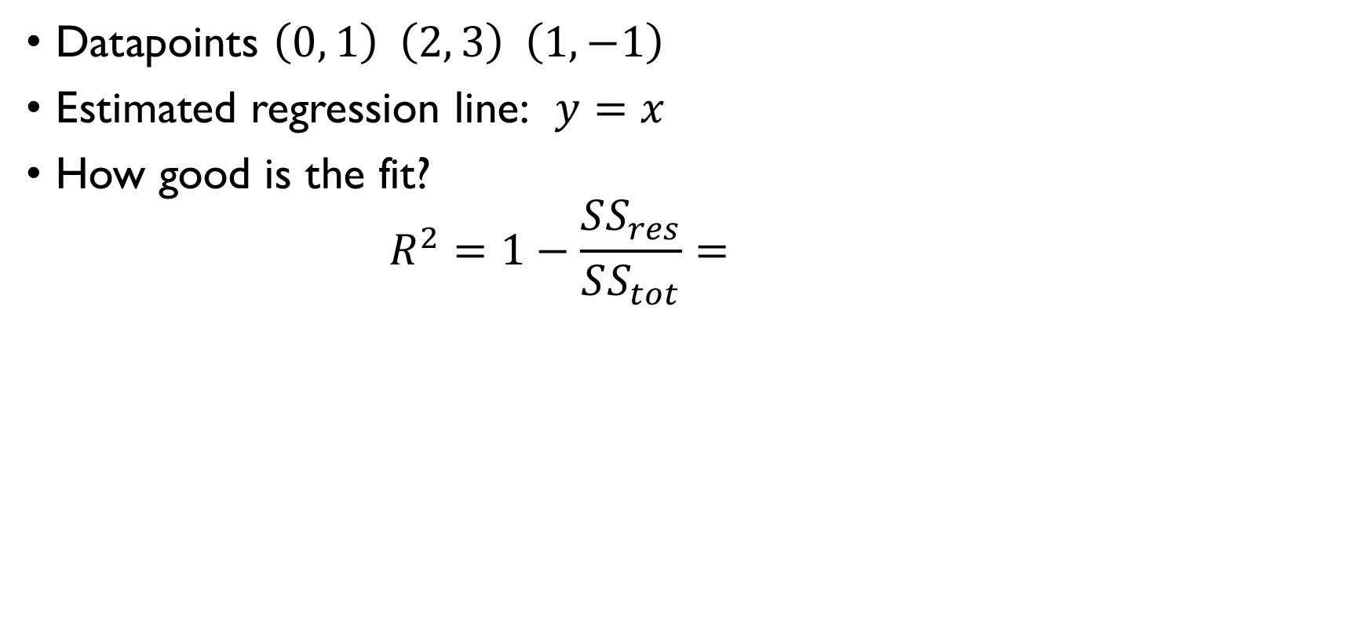
QUALITY OF THE FIT - EXAMPLE
Datapoints $\left(0, 1\right) \left(2, 3\right) \left(1,−1\right)$
Estimated regression line: $y=x$
How good is the fit?
$$R^{2}=1−\frac{SS_{res}}{SS_{tot}}=1−\frac{6}{8}=0.25$$
$$SS_{tot}=\frac{{\left(1−1\right)}^{2}+{\left(3−1\right)}^{2}+{\left(−1−1\right)}^{2}}{3}=\frac{8}{3}$$
$$SS_{res}=\frac{{\left(0−1\right)}^{2}+{\left(2−3\right)}^{2}+{\left(1+1\right)}^{2}}{3}=\frac{6}{3}$$

Slide 41
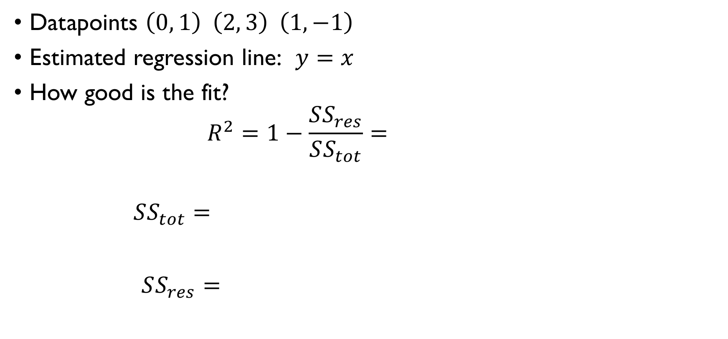
QUALITY OF THE FIT - EXAMPLE
Datapoints $\left(0, 1\right) \left(2, 3\right) \left(1,−1\right)$
Estimated regression line: $y=x$
How good is the fit?
$$R^{2}=1−\frac{SS_{res}}{SS_{tot}}=1−\frac{6}{8}=0.25$$
$$SS_{tot}=\frac{{\left(1−1\right)}^{2}+{\left(3−1\right)}^{2}+{\left(−1−1\right)}^{2}}{3}=\frac{8}{3}$$
$$SS_{res}=\frac{{\left(0−1\right)}^{2}+{\left(2−3\right)}^{2}+{\left(1+1\right)}^{2}}{3}=\frac{6}{3}$$

Slide 42
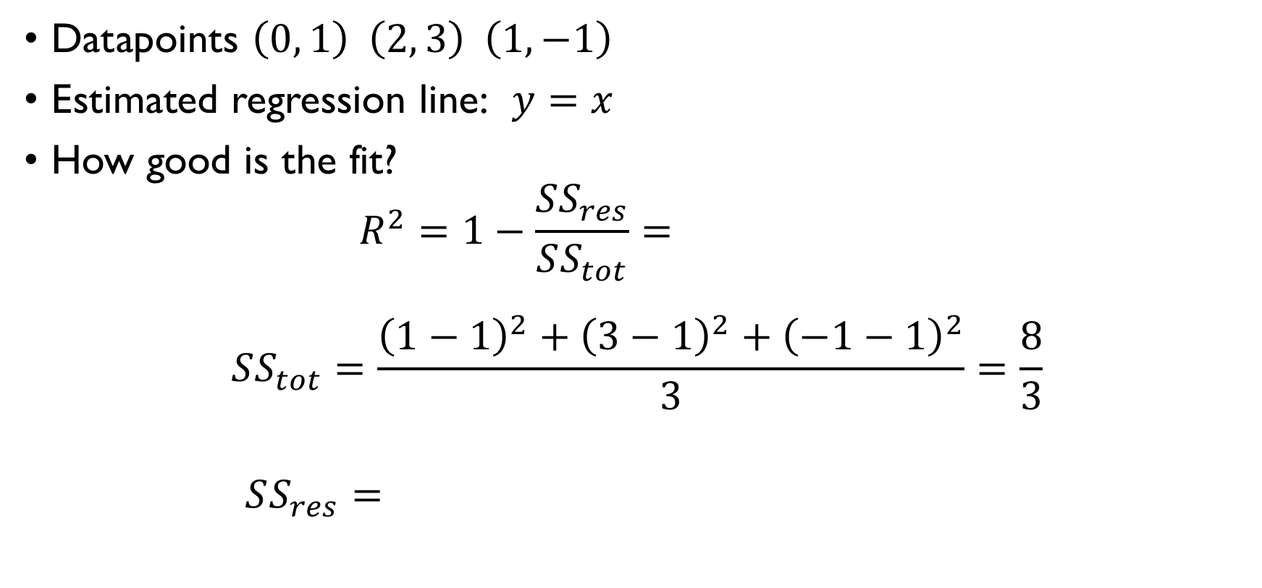
QUALITY OF THE FIT - EXAMPLE
Datapoints $\left(0, 1\right) \left(2, 3\right) \left(1,−1\right)$
Estimated regression line: $y=x$
How good is the fit?
$$R^{2}=1−\frac{SS_{res}}{SS_{tot}}=1−\frac{6}{8}=0.25$$
$$SS_{tot}=\frac{{\left(1−1\right)}^{2}+{\left(3−1\right)}^{2}+{\left(−1−1\right)}^{2}}{3}=\frac{8}{3}$$
$$SS_{res}=\frac{{\left(0−1\right)}^{2}+{\left(2−3\right)}^{2}+{\left(1+1\right)}^{2}}{3}=\frac{6}{3}$$

Slide 43
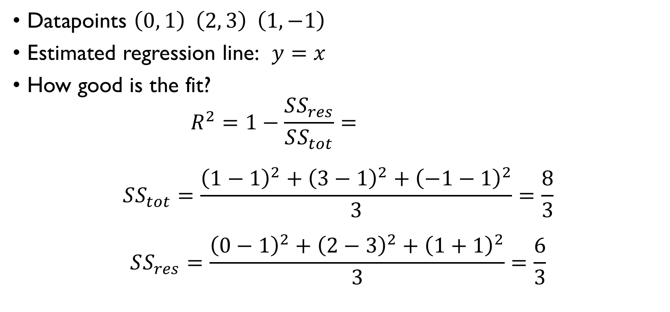
QUALITY OF THE FIT - EXAMPLE
Datapoints $\left(0, 1\right) \left(2, 3\right) \left(1,−1\right)$
Estimated regression line: $y=x$
How good is the fit?
$$R^{2}=1−\frac{SS_{res}}{SS_{tot}}=1−\frac{6}{8}=0.25$$
$$SS_{tot}=\frac{{\left(1−1\right)}^{2}+{\left(3−1\right)}^{2}+{\left(−1−1\right)}^{2}}{3}=\frac{8}{3}$$
$$SS_{res}=\frac{{\left(0−1\right)}^{2}+{\left(2−3\right)}^{2}+{\left(1+1\right)}^{2}}{3}=\frac{6}{3}$$

Slide 44
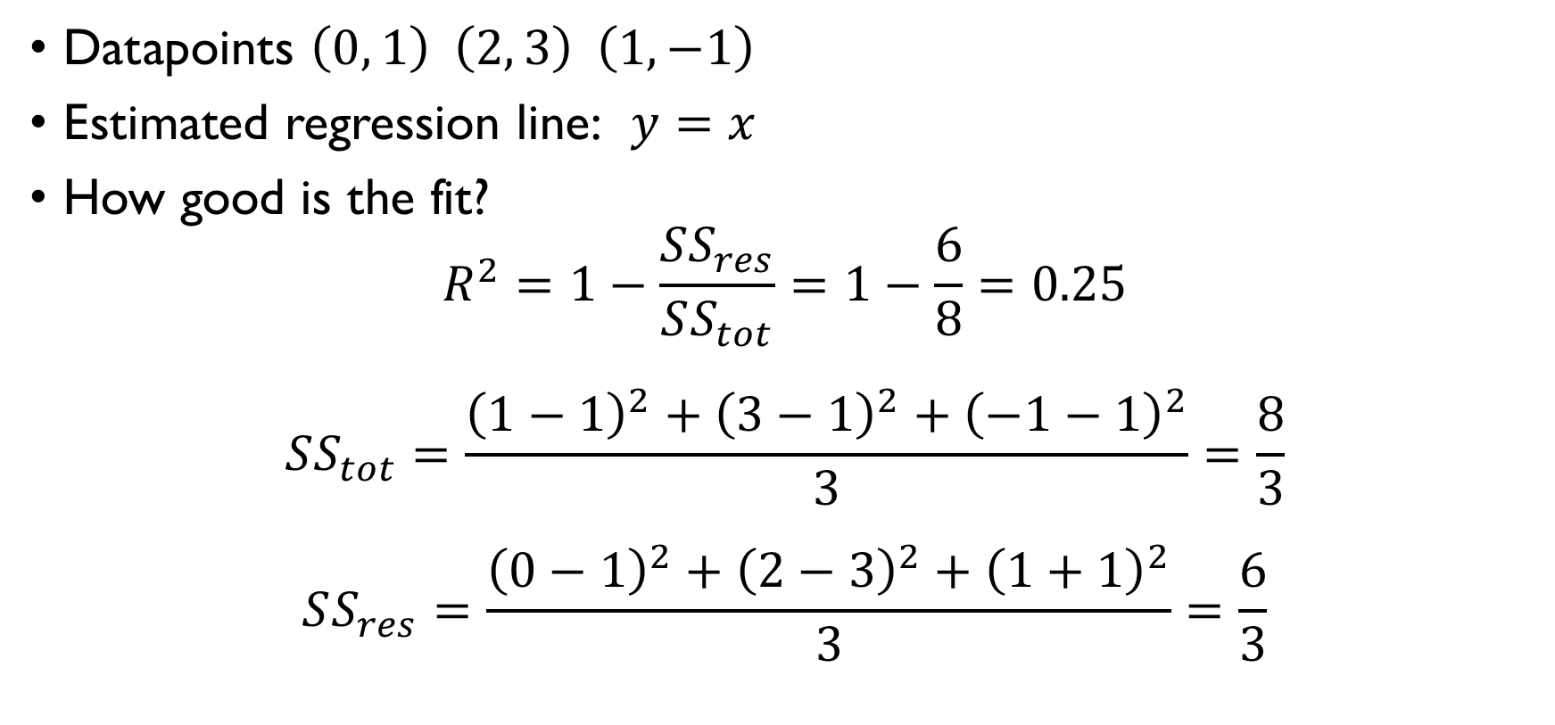
QUALITY OF THE FIT - EXAMPLE
Datapoints $\left(0, 1\right) \left(2, 3\right) \left(1,−1\right)$
Estimated regression line: $y=x$
How good is the fit?
$$R^{2}=1−\frac{SS_{res}}{SS_{tot}}=1−\frac{6}{8}=0.25$$
$$SS_{tot}=\frac{{\left(1−1\right)}^{2}+{\left(3−1\right)}^{2}+{\left(−1−1\right)}^{2}}{3}=\frac{8}{3}$$
$$SS_{res}=\frac{{\left(0−1\right)}^{2}+{\left(2−3\right)}^{2}+{\left(1+1\right)}^{2}}{3}=\frac{6}{3}$$

Slide 45
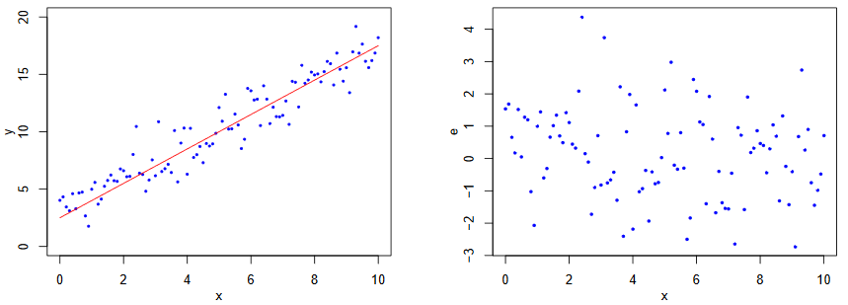
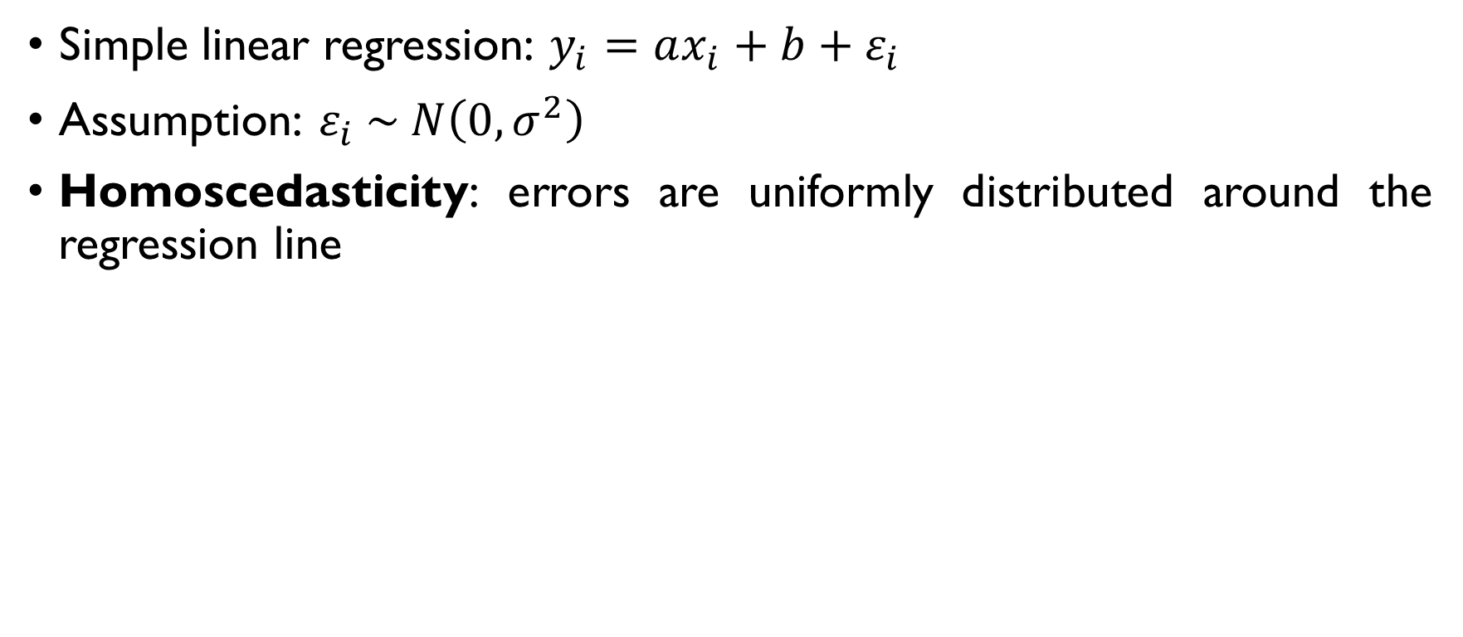
ASSUMPTIONS
Simple linear regression: $y_{i}=ax_{i}+b+ε_{i}$
Assumption: $ε_{i} \sim N\left(0,σ^{2}\right)$
Homoscedasticity: errors are uniformly distributed around the regression line

Slide 46
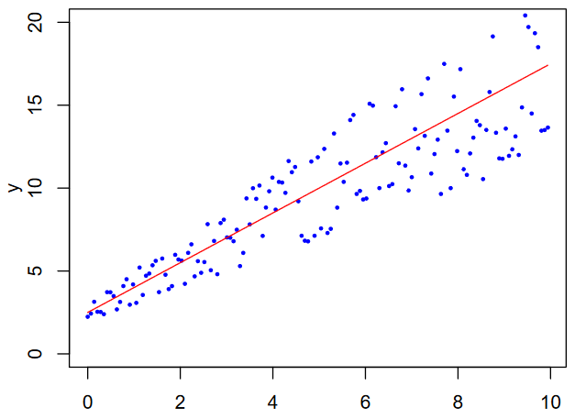
HETEROSCEDASTIC

Slide 47
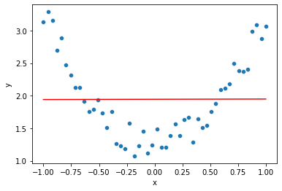
WHAT IS LINEAR THERE
Not all the data is linear

Slide 48
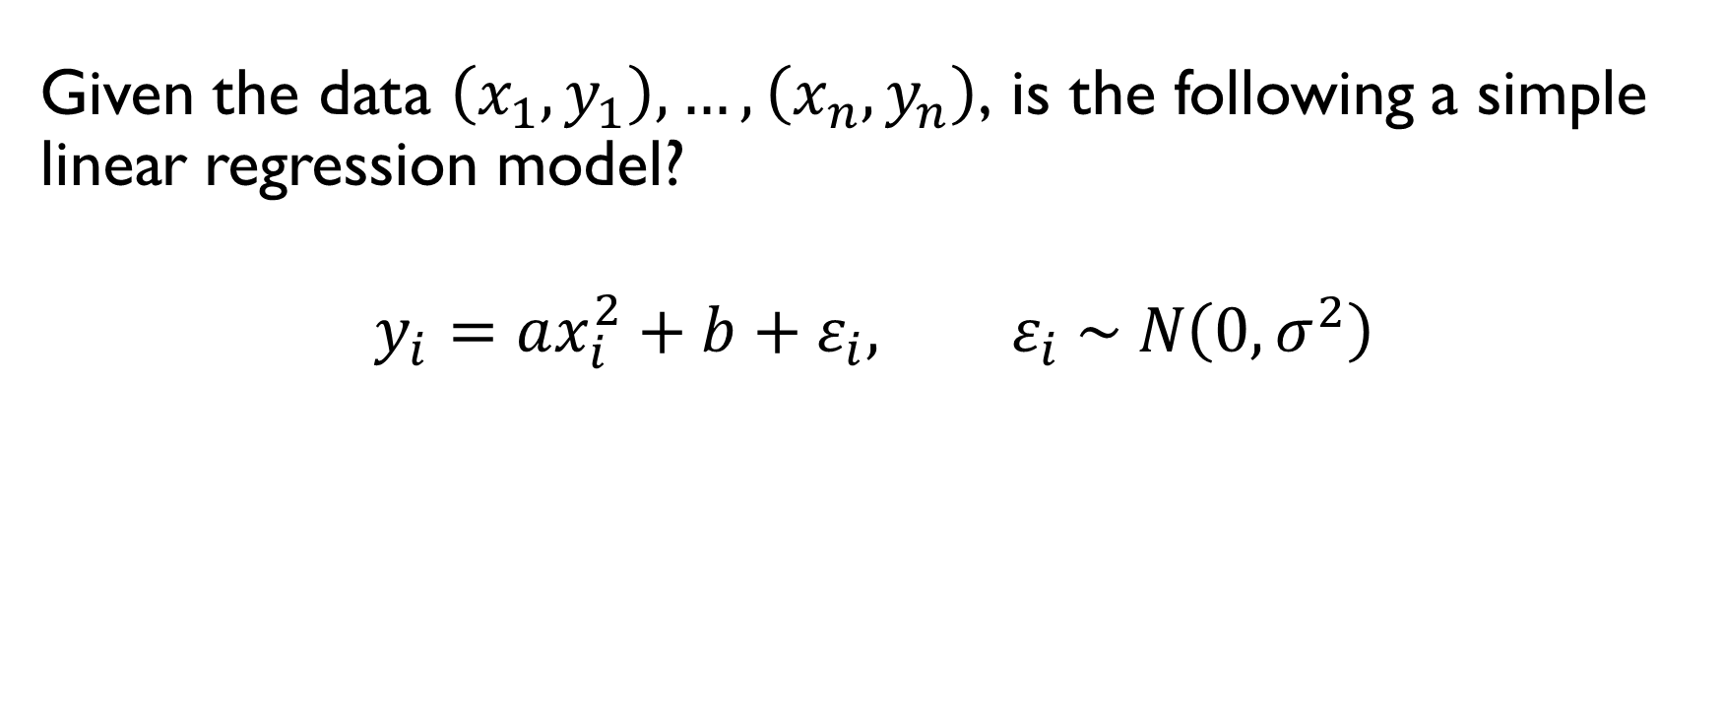
WHAT IS LINEAR THERE
Given the data $\left(x_{1},y_{1}\right),…,\left(x_{n},y_{n}\right)$, is the following a simple linear regression model?
$$y_{i}=ax_{i}^{2}+b+ε_{i}, ε_{i} \sim N\left(0,σ^{2}\right)$$
YES!
Linear in terms of parameters $a, b$, not in terms of the data.

Slide 49
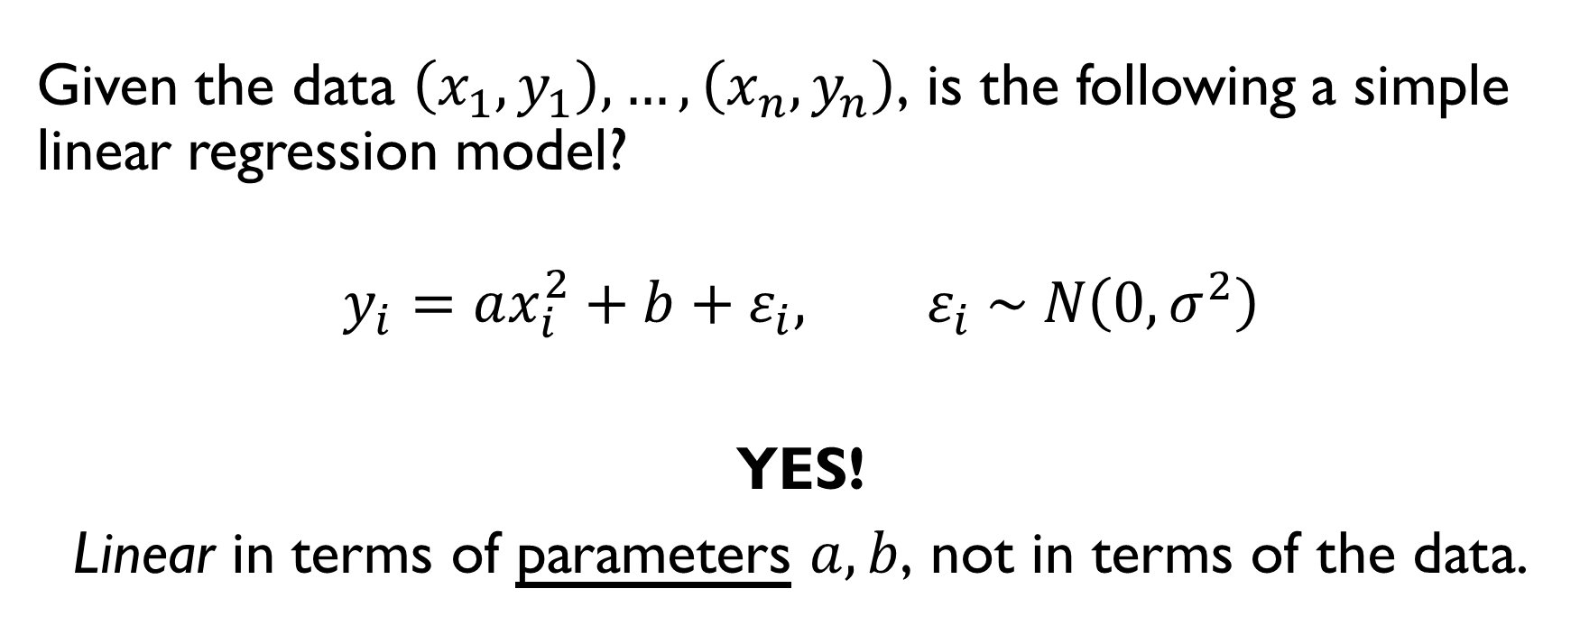
WHAT IS LINEAR THERE
Given the data $\left(x_{1},y_{1}\right),…,\left(x_{n},y_{n}\right)$, is the following a simple linear regression model?
$$y_{i}=ax_{i}^{2}+b+ε_{i}, ε_{i} \sim N\left(0,σ^{2}\right)$$
YES!
Linear in terms of parameters $a, b$, not in terms of the data.

Slide 50
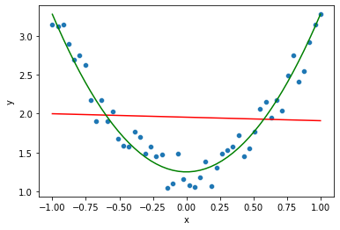
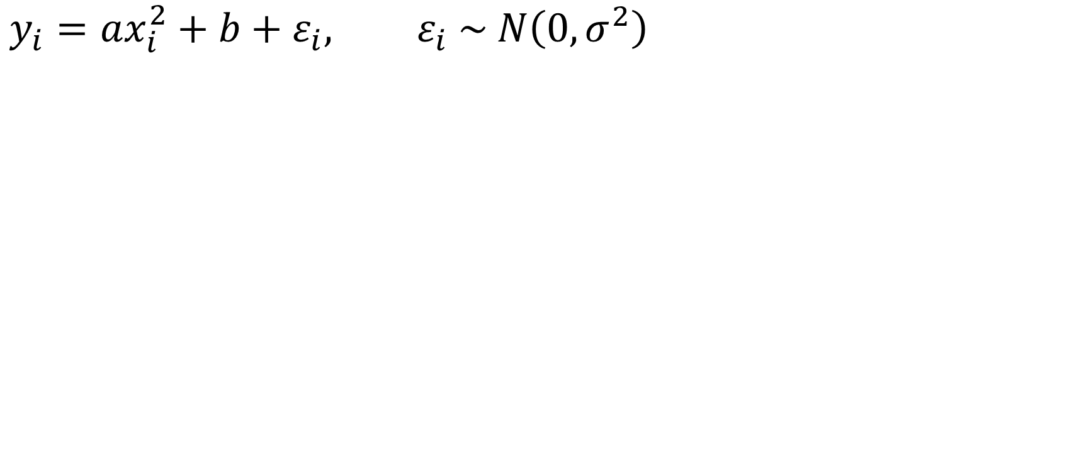
WHAT IS LINEAR THERE
$$y_{i}=ax_{i}^{2}+b+ε_{i}, ε_{i} \sim N\left(0,σ^{2}\right)$$

Slide 51
PRACTICE!
Google Classroom -> Lecture 12 -> Simple Linear Regression

Slide 52
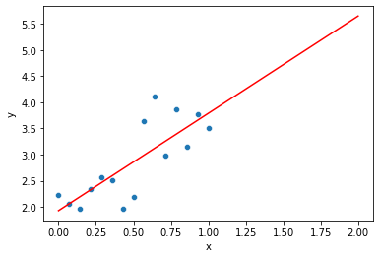
INTERPOLATION VS EXTRAPOLATION

Slide 53
INTERPOLATION VS EXTRAPOLATION

Slide 54
INTERPOLATION VS EXTRAPOLATION
interpolation

Slide 55
INTERPOLATION VS EXTRAPOLATION
extrapolation
interpolation

Slide 56

INTERPOLATION VS EXTRAPOLATION

Slide 57
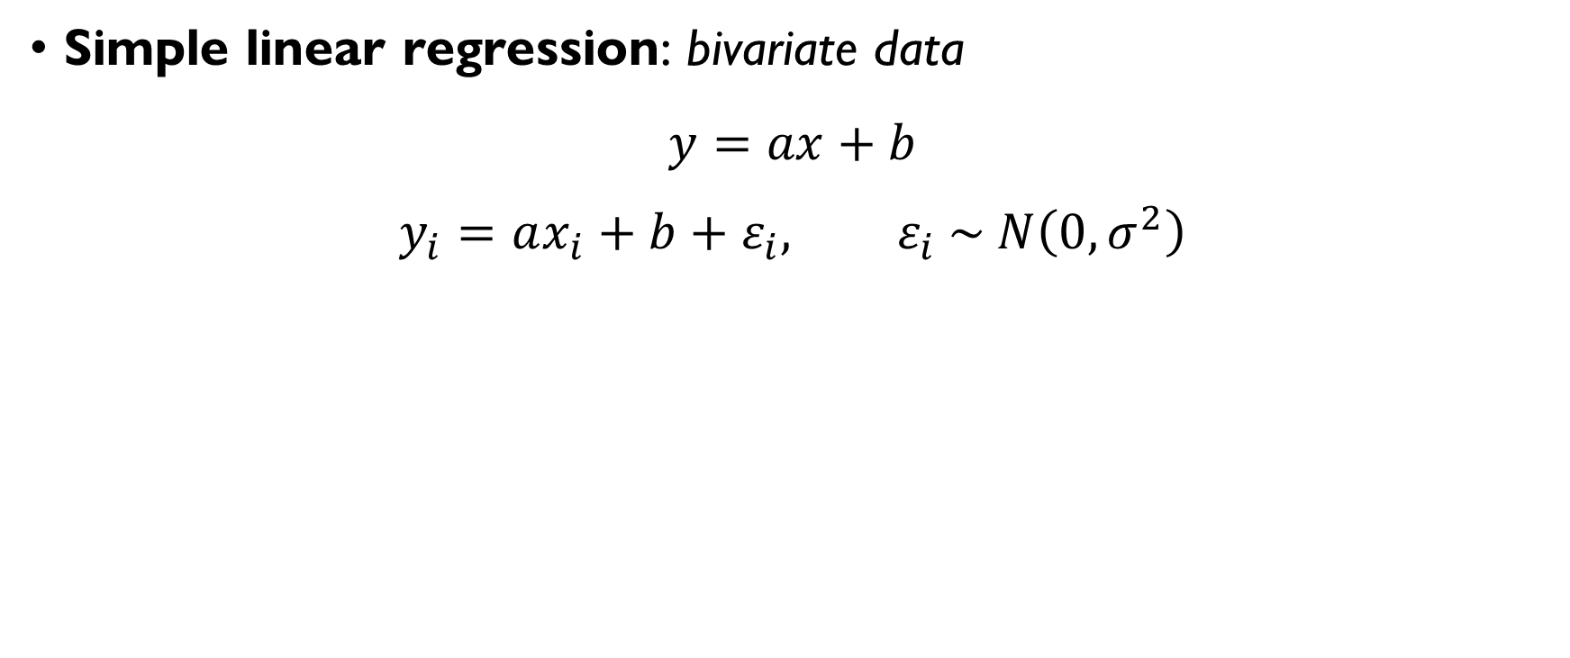
MULTIPLE LINEAR REGRESSION
Simple linear regression: bivariate data
$$y=ax+b$$
$$y_{i}=ax_{i}+b+ε_{i}, ε_{i} \sim N\left(0,σ^{2}\right)$$
Multiple linear regression: multivariate data
$$y=a_{1}x_{1}+a_{2}x_{2}+…+a_{m}x_{m}+b$$
$$y^{(i)}=a_{1}x_{1}^{\left(i\right)}+…+a_{m}x_{m}^{\left(i\right)}+b+ε_{i}, ε_{i} \sim N\left(0,σ^{2}\right)$$

Slide 58
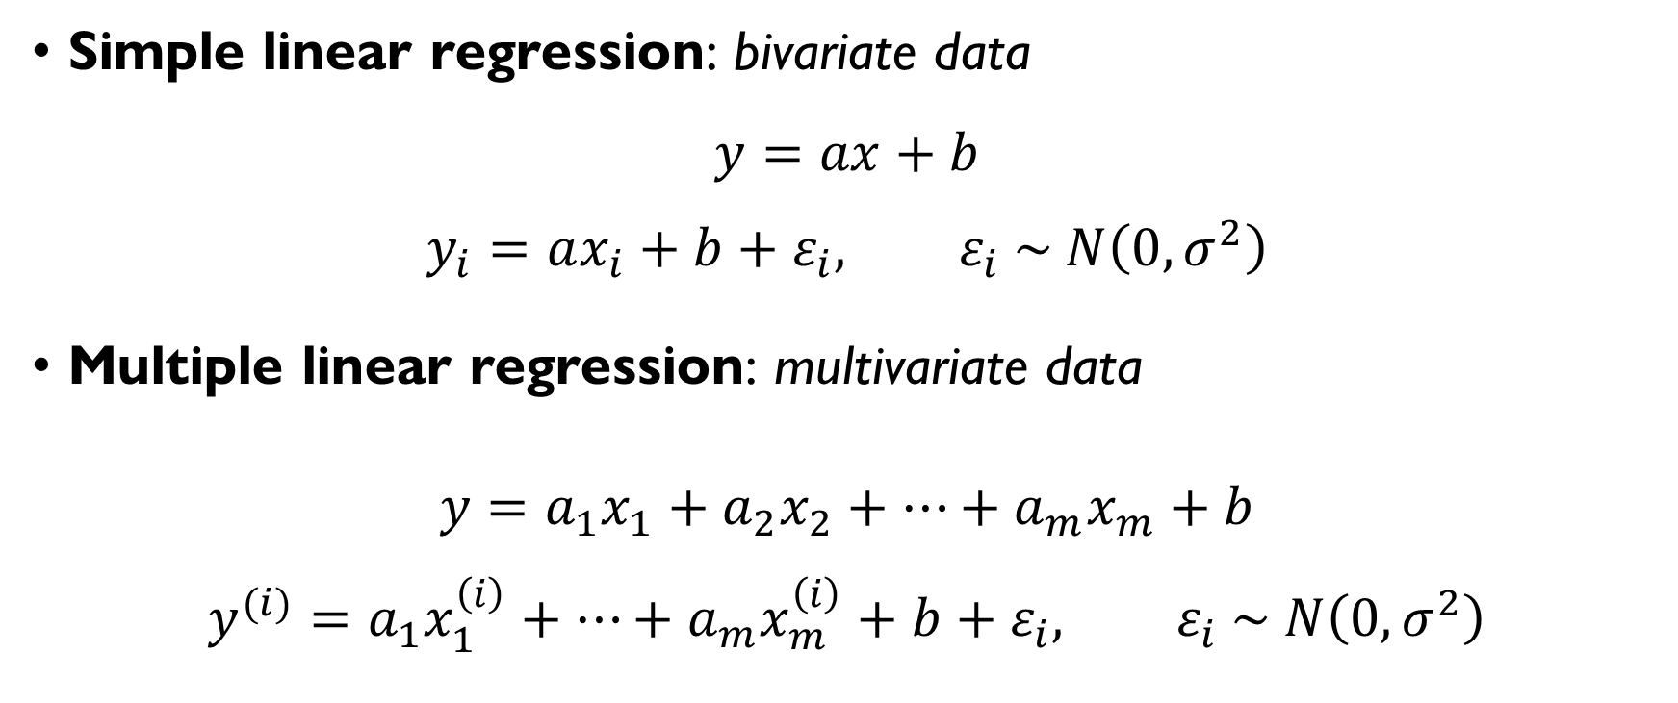
MULTIPLE LINEAR REGRESSION
Simple linear regression: bivariate data
$$y=ax+b$$
$$y_{i}=ax_{i}+b+ε_{i}, ε_{i} \sim N\left(0,σ^{2}\right)$$
Multiple linear regression: multivariate data
$$y=a_{1}x_{1}+a_{2}x_{2}+…+a_{m}x_{m}+b$$
$$y^{(i)}=a_{1}x_{1}^{\left(i\right)}+…+a_{m}x_{m}^{\left(i\right)}+b+ε_{i}, ε_{i} \sim N\left(0,σ^{2}\right)$$

Slide 59
RECAP

Slide 60
WHAT WE’VE SEEN IN THIS COURSE
Probability theory
Discrete and continuous random variables
Expectation, (co-)variance, correlation
Basic distributions
CDFs and PDFs
Descriptive Statistics
Summary statistics (sample mean, sample variance, median, …)
Basic plots
Inferential Statistics
Parameter estimation
point estimates (maximum likelihood);
confidence intervals.
Hypothesis testing

Slide 61
WHAT WE’VE SEEN IN THIS COURSE
Probability theory
Discrete and continuous random variables
Expectation, (co-)variance, correlation
Basic distributions
CDFs and PDFs
Descriptive Statistics
Summary statistics (sample mean, sample variance, median, …)
Basic plots
Inferential Statistics
Parameter estimation
point estimates (maximum likelihood);
confidence intervals.
Hypothesis testing

Slide 62
WHAT WE’VE SEEN IN THIS COURSE
Probability theory
Discrete and continuous random variables
Expectation, (co-)variance, correlation
Basic distributions
CDFs and PDFs
Descriptive Statistics
Summary statistics (sample mean, sample variance, median, …)
Basic plots
Inferential Statistics
Parameter estimation
point estimates (maximum likelihood);
confidence intervals.
Hypothesis testing

Slide 63
PROBABILITY THEORY

Slide 64
Discrete random variables can take only countably many values.0!

Slide 65
Discrete random variables can take only countably many values.0!

Slide 66

SOME DISCRETE DISTRIBUTIONS
Bernoulli
X ~ Bernoulli(p) $P\left(X=1\right)=p, P\left(X=0\right)=1−p$
E(X) = p Chance of success in a single trial with two outcomes
Binomial
X ~ Bi(n, p), $P\left(X=k\right)=C_{n}^{k}p^{k}{\left(1−p\right)}^{n−k}, 0≤k≤1$
E(X) = np # of successes in a series of n Bernoulli trials
Poisson
X ~ Po(λ), $P\left(X=k\right)=\frac{e^{−λ}∙λ^{k}}{k!}, k≥0$
E(X) = λ # events that occur within a fixed amount of time

Slide 67

SOME DISCRETE DISTRIBUTIONS
Bernoulli
X ~ Bernoulli(p) $P\left(X=1\right)=p, P\left(X=0\right)=1−p$
E(X) = p Chance of success in a single trial with two outcomes
Binomial
X ~ Bi(n, p), $P\left(X=k\right)=C_{n}^{k}p^{k}{\left(1−p\right)}^{n−k}, 0≤k≤1$
E(X) = np # of successes in a series of n Bernoulli trials
Poisson
X ~ Po(λ), $P\left(X=k\right)=\frac{e^{−λ}∙λ^{k}}{k!}, k≥0$
E(X) = λ # events that occur within a fixed amount of time

Slide 68

SOME DISCRETE DISTRIBUTIONS
Bernoulli
X ~ Bernoulli(p) $P\left(X=1\right)=p, P\left(X=0\right)=1−p$
E(X) = p Chance of success in a single trial with two outcomes
Binomial
X ~ Bi(n, p), $P\left(X=k\right)=C_{n}^{k}p^{k}{\left(1−p\right)}^{n−k}, 0≤k≤1$
E(X) = np # of successes in a series of n Bernoulli trials
Poisson
X ~ Po(λ), $P\left(X=k\right)=\frac{e^{−λ}∙λ^{k}}{k!}, k≥0$
E(X) = λ # events that occur within a fixed amount of time

Slide 69

SOME DISCRETE DISTRIBUTIONS
Bernoulli
X ~ Bernoulli(p) $P\left(X=1\right)=p, P\left(X=0\right)=1−p$
E(X) = p Chance of success in a single trial with two outcomes
Binomial
X ~ Bi(n, p), $P\left(X=k\right)=C_{n}^{k}p^{k}{\left(1−p\right)}^{n−k}, 0≤k≤1$
E(X) = np # of successes in a series of n Bernoulli trials
Poisson
X ~ Po(λ), $P\left(X=k\right)=\frac{e^{−λ}∙λ^{k}}{k!}, k≥0$
E(X) = λ # events that occur within a fixed amount of time

Slide 70
Continuous random variables can take uncountably many values.0!

Slide 71

CDF & PDF
Probability mass function (discrete random variables):
$$P\left(X=x\right)$$
Cumulative distribution function (CDF):
$$F\left(x\right)=P\left(X≤x\right)$$
Probability density function (PDF) (continuous random variables):
$$F\left(x\right)=\int_{−∞}^{x}{p\left(t\right)dt}$$

Slide 72
The probability that a continuous random variable takes a particular value is…

Slide 73
The probability that a continuous random variable takes a particular value is 0!

Slide 74


CDF
Consider random variable X:
What’s the CDF of X?
$$F\left(x\right)=P\left(X≤x\right)=\left\{\begin{aligned}0, x<1 \\ {0.25, 1≤x<2 \atop 0.75, 2≤x<3} \\ 1, x≥3\end{aligned}\right.$$
$$x$$ | 1 | 2 | 3
$$P(X=x)$$ | 0.25 | 0.5 | 0.25

Slide 75

CDF
Consider random variable X:
What’s the CDF of X?
$$F\left(x\right)=P\left(X≤x\right)=\left\{\begin{aligned}0, x<1 \\ {0.25, 1≤x<2 \atop 0.75, 2≤x<3} \\ 1, x≥3\end{aligned}\right.$$
$$x$$ | 1 | 2 | 3
$$P(X=x)$$ | 0.25 | 0.5 | 0.25

Slide 76

CDF
Consider random variable X:
What’s the CDF of X?
$$F\left(x\right)=P\left(X≤x\right)=\left\{\begin{aligned}0, x<1 \\ {0.25, 1≤x<2 \atop 0.75, 2≤x<3} \\ 1, x≥3\end{aligned}\right.$$
$$x$$ | 1 | 2 | 3
$$P(X=x)$$ | 0.25 | 0.5 | 0.25

Slide 77

CDF
Consider random variable X:
What’s the CDF of X?
$$F\left(x\right)=P\left(X≤x\right)=\left\{\begin{aligned}0, x<1 \\ {0.25, 1≤x<2 \atop 0.75, 2≤x<3} \\ 1, x≥3\end{aligned}\right.$$
$$x$$ | 1 | 2 | 3
$$P(X=x)$$ | 0.25 | 0.5 | 0.25

Slide 78

CDF
Consider random variable X:
What’s the CDF of X?
$$F\left(x\right)=P\left(X≤x\right)=\left\{\begin{aligned}0, x<1 \\ {0.25, 1≤x<2 \atop 0.75, 2≤x<3} \\ 1, x≥3\end{aligned}\right.$$
$$x$$ | 1 | 2 | 3
$$P(X=x)$$ | 0.25 | 0.5 | 0.25

Slide 79

WHAT IS DIFFERENT FROM THE REST
$P\left(X≤3\right)$
$\int_{3}^{+∞}{p\left(x\right)dx}$
$F\left(3\right)$
$\int_{−∞}^{3}{p\left(x\right)dx}$

Slide 80

WHAT IS DIFFERENT FROM THE REST
$P\left(X≤3\right)$
$\int_{3}^{+∞}{p\left(x\right)dx}=P\left(X≥3\right)$
$F\left(3\right)=P(X<3)$
$\int_{−∞}^{3}{p\left(x\right)dx}=F\left(3\right)=P\left(X<3\right)$

Slide 81

WHAT IS DIFFERENT FROM THE REST
$P\left(X>5\right)$
$\int_{5}^{+∞}{p\left(x\right)dx}$
$\int_{−∞}^{5}{p\left(x\right)dx}$
$1−F\left(5\right)$

Slide 82

WHAT IS DIFFERENT FROM THE REST
$P\left(X>5\right)$
$\int_{5}^{+∞}{p\left(x\right)dx}=P\left(X≥5\right)$
$\int_{−∞}^{5}{p\left(x\right)dx}=F\left(5\right)=P\left(X<5\right)$
$1−F\left(5\right)=P\left(X≥5\right)$

Slide 83

WHAT IS DIFFERENT FROM THE REST
$\int_{3}^{5}{p\left(x\right)dx}$
$P\left(3<X≤5\right)$
$F\left(3\right)−F\left(5\right)$
$\int_{−∞}^{5}{p\left(x\right)dx}−\int_{−∞}^{3}{p\left(x\right)dx}$

Slide 84

WHAT IS DIFFERENT FROM THE REST
$\int_{3}^{5}{p\left(x\right)dx}=F\left(5\right)−F\left(3\right)=P\left(3<X≤5\right)$
$P\left(3<X≤5\right)$
$F\left(3\right)−F\left(5\right)=−P\left(3<X≤5\right)$
$\int_{−∞}^{5}{p\left(x\right)dx}−\int_{−∞}^{3}{p\left(x\right)dx}=F\left(5\right)−F\left(3\right)=P\left(3<X≤5\right)$

Slide 85


EXPECTED VALUE
DISCRETE RANDOM VARIABLE
CONTINUOUS RANDOM VARIABLE
Sum up all the values a random variable can take, multiplying them by their probabilities:
$$E\left(X\right)=\sum_{X_{i}}{X_{i}∙P\left(X=X_{i}\right)}$$
Same principle:
$$E\left(X\right)=\int_{−∞}^{+∞}{x∙p\left(x\right)dx}$$

Slide 86


EXPECTED VALUE
DISCRETE RANDOM VARIABLE
CONTINUOUS RANDOM VARIABLE
Sum up all the values a random variable can take, multiplying them by their probabilities:
$$E\left(X\right)=\sum_{X_{i}}{X_{i}∙P\left(X=X_{i}\right)}$$
$$E\left(f(X)\right)=\sum_{X_{i}}{f(X_{i})∙P\left(X=X_{i}\right)}$$
Same principle:
$$E\left(X\right)=\int_{−∞}^{+∞}{x∙p\left(x\right)dx}$$
$$E\left(f\left(X\right)\right)=\int_{−∞}^{+∞}{f\left(x\right)∙p\left(x\right)dx}$$

Slide 87


EXPECTED VALUE
Consider a random variable X:
$E\left(X\right)=\frac{1}{4}+\frac{2}{2}+\frac{3}{4}=2$
$E\left(X^{2}\right)=\frac{1^{2}}{4}+\frac{2^{2}}{2}+\frac{3^{2}}{4}=4.5$
$$x$$ | 1 | 2 | 3
$$P(X=x)$$ | 0.25 | 0.5 | 0.25

Slide 88

EXPECTED VALUE
Consider a random variable X:
$E\left(X\right)=\frac{1}{4}+\frac{2}{2}+\frac{3}{4}=2$
$E\left(X^{2}\right)=\frac{1^{2}}{4}+\frac{2^{2}}{2}+\frac{3^{2}}{4}=4.5$
$$x$$ | 1 | 2 | 3
$$P(X=x)$$ | 0.25 | 0.5 | 0.25

Slide 89

EXPECTED VALUE
Consider a random variable X:
$E\left(X\right)=\frac{1}{4}+\frac{2}{2}+\frac{3}{4}=2$
$E\left(X^{2}\right)=\frac{1^{2}}{4}+\frac{2^{2}}{2}+\frac{3^{2}}{4}=4.5$
$$x$$ | 1 | 2 | 3
$$P(X=x)$$ | 0.25 | 0.5 | 0.25

Slide 90

EXPECTED VALUE
$$X \sim U\left(1,2\right)$$
$$E\left(X\right)=\frac{2−1}{2}=\frac{3}{2}$$
$$E\left(\frac{1}{X}\right)=\int_{1}^{2}{\frac{1}{x}∙\frac{1}{2}dx=\log{2}−\log{1}=\log{2}}$$

Slide 91

EXPECTED VALUE
$$X \sim U\left(1,2\right)$$
$$E\left(X\right)=\frac{2−1}{2}=\frac{3}{2}$$
$$E\left(\frac{1}{X}\right)=\int_{1}^{2}{\frac{1}{x}∙\frac{1}{2}dx=\log{2}−\log{1}=\log{2}}$$

Slide 92

EXPECTED VALUE
$$X \sim U\left(1,2\right)$$
$$E\left(X\right)=\frac{2−1}{2}=\frac{3}{2}$$
$$E\left(\frac{1}{X}\right)=\int_{1}^{2}{\frac{1}{x}∙1dx=\log{2}−\log{1}=\log{2}}$$

Slide 93

EXPECTED VALUE
$$X \sim U\left(1,2\right)$$
$$E\left(X\right)=\frac{2−1}{2}=\frac{3}{2}$$
$$E\left(\frac{1}{X}\right)=\int_{1}^{2}{\frac{1}{x}∙1dx=\log{2}−\log{1}=\log{2}}$$

Slide 94

VARIANCE
DISCRETE RANDOM VARIABLE
CONTINUOUS RANDOM VARIABLE
Expected squared distance between a value and the mean:
$$Var\left(X\right)=E\left({\left(X −E\left(X\right)\right)}^{2}\right)=E\left(X^{2}\right)−{\left(E\left(X\right)\right)}^{2}$$

Slide 95

LINEAR COMBINATION OF NORMALLY DISTRIBUTED VARIABLES
A linear combination of independent random variables having a normal distribution also has a normal distribution:
$X_{1},X_{2},…,X_{n}$ - independent
$$X_{i} \sim N\left(μ_{i}, σ_{i}^{2}\right)$$
$$Y=a_{1}X_{1}+a_{2}X_{2}+…+a_{3}X_{3}⇒$$
$$Y \sim N\left(μ_{Y},σ_{Y}^{2}\right)$$
$$μ_{Y}=a_{1}μ_{1}+a_{2}μ_{2}+…+a_{n}μ_{n}, σ_{Y}^{2}=a_{1}^{2}σ_{1}^{2}+a_{2}^{2}σ_{2}^{2}+…+a_{n}^{2}σ_{n}^{2}$$

Slide 96

LINEAR COMBINATION OF NORMALLY DISTRIBUTED VARIABLES
A linear combination of independent random variables having a normal distribution also has a normal distribution:
$X_{1},X_{2},…,X_{n}$ - independent
$$X_{i} \sim N\left(μ_{i}, σ_{i}^{2}\right)$$
$$Y=a_{1}X_{1}+a_{2}X_{2}+…+a_{3}X_{3}⇒$$
$$Y \sim N\left(μ_{Y},σ_{Y}^{2}\right)$$
$$μ_{Y}=a_{1}μ_{1}+a_{2}μ_{2}+…+a_{n}μ_{n}, σ_{Y}^{2}=a_{1}^{2}σ_{1}^{2}+a_{2}^{2}σ_{2}^{2}+…+a_{n}^{2}σ_{n}^{2}$$

Slide 97
LINEAR COMBINATION OF NORMALLY DISTRIBUTED VARIABLES
A linear combination of independent random variables having a normal distribution also has a normal distribution:
$X_{1},X_{2},…,X_{n}$ - independent
$$X_{i} \sim N\left(μ_{i}, σ_{i}^{2}\right)$$
$$Y=a_{1}X_{1}+a_{2}X_{2}+…+a_{3}X_{3}⇒$$
$$Y \sim N\left(μ_{Y},σ_{Y}^{2}\right)$$
$$μ_{Y}=a_{1}μ_{1}+a_{2}μ_{2}+…+a_{n}μ_{n}, σ_{Y}^{2}=a_{1}^{2}σ_{1}^{2}+a_{2}^{2}σ_{2}^{2}+…+a_{n}^{2}σ_{n}^{2}$$

Slide 98

CENTRAL LIMIT THEOREM
Samples $X_{1}, X_{2}, …, X_{n}:$
i.i.d.
a finite mean $μ$ and finite variance $σ^{2}$
Let
$${\overline{X}}_{n}=\frac{1}{n}\sum_{i=1}^{n}{X_{i}}$$
Then
$${\overline{X}}_{n}≈N\left(μ, \frac{σ^{2}}{n}\right)$$

Slide 99

CENTRAL LIMIT THEOREM
Samples $X_{1}, X_{2}, …, X_{n}:$
i.i.d.
a finite mean $μ$ and finite variance $σ^{2}$
Let
$${\overline{X}}_{n}=\frac{1}{n}\sum_{i=1}^{n}{X_{i}}$$
Then
$${\overline{X}}_{n}≈N\left(μ, \frac{σ^{2}}{n}\right)$$

Slide 100

CENTRAL LIMIT THEOREM
Samples $X_{1}, X_{2}, …, X_{n}:$
i.i.d.
a finite mean $μ$ and finite variance $σ^{2}$
Let
$${\overline{X}}_{n}=\frac{1}{n}\sum_{i=1}^{n}{X_{i}}$$
Then
$${\overline{X}}_{n}≈N\left(μ, \frac{σ^{2}}{n}\right)$$

Slide 101

COVARIANCE AND CORRELATION
Covariance:
$$σ_{XY}^{2}=E\left[\left(X−\overline{X}\right)\left(Y−\overline{Y}\right)\right]=E\left(XY\right)−\overline{X}\overline{Y}$$
Correlation:
$$ρ=\frac{σ_{XY}^{2}}{σ_{X}σ_{Y}}=\frac{E\left(X−\overline{X}\right)\left(Y−\overline{Y}\right)}{\sqrt{E{\left(X−\overline{X}\right)}^{2}E{\left(Y−\overline{Y}\right)}^{2}}}$$

Slide 102

COVARIANCE AND CORRELATION
Covariance:
$$σ_{XY}^{2}=E\left[\left(X−\overline{X}\right)\left(Y−\overline{Y}\right)\right]=E\left(XY\right)−\overline{X}\overline{Y}$$
Correlation:
$$ρ=\frac{σ_{XY}^{2}}{σ_{X}σ_{Y}}=\frac{E\left(X−\overline{X}\right)\left(Y−\overline{Y}\right)}{\sqrt{E{\left(X−\overline{X}\right)}^{2}E{\left(Y−\overline{Y}\right)}^{2}}}$$

Slide 103
INFERENTIAL STATISTICS

Slide 104

TWO TYPES OF STATISTICS
$$X \sim N\left(μ,σ^{2}\right)$$
Sample: $X_{1},X_{2},…,X_{n}$
Descriptive statistics: describe your sample
$\overline{X}=\frac{1}{n}\sum{X_{i}}−$sample mean
$s^{2}=\frac{1}{n}\sum{X_{i}^{2}−{\overline{X}}^{2}}−$ sample variance

Slide 105

TWO TYPES OF STATISTICS
$$X \sim N\left(μ,σ^{2}\right)$$
Sample: $X_{1},X_{2},…,X_{n}$
Descriptive statistics: describe your sample
$\overline{X}=\frac{1}{n}\sum{X_{i}}−$sample mean
$s^{2}=\frac{1}{n}\sum{X_{i}^{2}−{\overline{X}}^{2}}−$ sample variance

Slide 106

TWO TYPES OF STATISTICS
$$X \sim N\left(μ,σ^{2}\right)$$
Sample: $X_{1},X_{2},…,X_{n}$
Descriptive statistics: describe your sample
$\overline{X}=\frac{1}{n}\sum{X_{i}}−$sample mean
$s^{2}=\frac{1}{n}\sum{X_{i}^{2}−{\overline{X}}^{2}}−$ sample variance

Slide 107

TWO TYPES OF STATISTICS
$$X \sim N\left(μ,σ^{2}\right)$$
Sample: $X_{1},X_{2},…,X_{n}$
Descriptive statistics: describe your sample
$\overline{X}=\frac{1}{n}\sum{X_{i}}−$sample mean
$s^{2}=\frac{1}{n}\sum{X_{i}^{2}−{\overline{X}}^{2}}−$ sample variance

Slide 108

TWO TYPES OF STATISTICS
$$X \sim N\left(μ,σ^{2}\right)$$
Sample: $X_{1},X_{2},…,X_{n}$
Inferential Statistics: reason about the values of the unknown parameters
$\hat{μ}, {\hat{σ}}^{2}−$ point estimates
$μ∈\overline{X}±z_{1−\frac{α}{2}}\frac{σ}{\sqrt{n}} −$ confidence intervals
$H_{0}:μ=5, H_{1}:μ≠5 −$ hypothesis testing

Slide 109

TWO TYPES OF STATISTICS
$$X \sim N\left(μ,σ^{2}\right)$$
Sample: $X_{1},X_{2},…,X_{n}$
Inferential Statistics: reason about the values of the unknown parameters of the underlying distribution
$\hat{μ}, {\hat{σ}}^{2}−$ point estimates
$μ∈\overline{X}±z_{1−\frac{α}{2}}\frac{σ}{\sqrt{n}} −$ confidence intervals
$H_{0}:μ=5, H_{1}:μ≠5 −$ hypothesis testing

Slide 110

TWO TYPES OF STATISTICS
$$X \sim N\left(μ,σ^{2}\right)$$
Sample: $X_{1},X_{2},…,X_{n}$
Inferential Statistics: reason about the values of the unknown parameters of the underlying distribution
$\hat{μ}, {\hat{σ}}^{2}−$ point estimates
$μ∈\overline{X}±z_{1−\frac{α}{2}}\frac{σ}{\sqrt{n}} −$ confidence intervals
$H_{0}:μ=5, H_{1}:μ≠5 −$ hypothesis testing

Slide 111

TWO TYPES OF STATISTICS
$$X \sim N\left(μ,σ^{2}\right)$$
Sample: $X_{1},X_{2},…,X_{n}$
Inferential Statistics: reason about the values of the unknown parameters of the underlying distribution
$\hat{μ}, {\hat{σ}}^{2}−$ point estimates
$μ∈\overline{X}±z_{1−\frac{α}{2}}\frac{σ}{\sqrt{n}} −$ confidence intervals
$H_{0}:μ=5, H_{1}:μ≠5 −$ hypothesis testing

Slide 112

TWO TYPES OF STATISTICS
$$X \sim N\left(μ,σ^{2}\right)$$
Sample: $X_{1},X_{2},…,X_{n}$
Inferential Statistics: reason about the values of the unknown parameters of the underlying distribution
$\hat{μ}, {\hat{σ}}^{2}−$ point estimates
$μ∈\overline{X}±z_{1−\frac{α}{2}}\frac{σ}{\sqrt{n}} −$ confidence intervals
$H_{0}:μ=5, H_{1}:μ≠5 −$ hypothesis testing

Slide 113

MAXIMUM LIKELIHOOD ESTIMATE
1. Write down the likelihood function:
Discrete: L($θ$) = $\prod_{i=1}^{n}{\text{P}\text{(}\text{X}\text{=}\text{Xi}\text{ | }θ\text{)}}$ Continuous: L($θ$) = $\prod_{i=1}^{n}{\text{p}\text{(}\text{Xi}\text{ | }θ\text{)}}$
2. Find its maximum w.r.t. the unknown parameter $θ$:
$\hat{Θ}$ = argmax L($θ$) w.r.t. $θ$
(!) In many cases, it’s easier to maximize log-likelihood:
Discrete: log L($θ$) = $\sum_{i=1}^{n}{\text{log} \text{P}\text{(}\text{X}\text{=}\text{Xi}\text{ | }θ\text{)}}$ Continuous: log L($θ$) = $\sum_{i=1}^{n}{\text{log} \text{p}\text{(}\text{Xi}\text{ | }θ\text{)}}$
$\hat{Θ}$= argmax log L($θ$)

Slide 114

MLE EXAMPLE
Simple linear regression:
$$y_{i}=ax_{i}+b+ε_{i}, ε_{i}\sim N\left(o,σ^{2}\right)$$
We obtain model parameters by least squares:
$$a,b: \sum{{\left(y_{i}−ax_{i}−b\right)}^{2}→min}$$
Show that it’s ML estimate of the parameters.

Slide 115

MLE EXAMPLE
Simple linear regression:
$$y_{i}=ax_{i}+b+ε_{i}, ε_{i}\sim N\left(o,σ^{2}\right)$$
We obtain model parameters by least squares:
$$a,b: \sum{{\left(y_{i}−ax_{i}−b\right)}^{2}→min}$$
Show that it’s ML estimate of the parameters.

Slide 116

MLE EXAMPLE
$$y_{i}=ax_{i}+b+ε_{i}, ε_{i}\sim N\left(o,σ^{2}\right)$$
$$y_{i} \sim N\left(ax_{i}+b,σ^{2}\right)$$
$$L\left(a,b\right)=\prod_{i=1}^{n}{\frac{1}{\sqrt{2π}σ}e^{−\frac{1}{2}{\left(\frac{y_{i}−ax_{i}−b}{σ}\right)}^{2}}}→max$$
$${⟺\left(y_{i}−ax_{i}−b\right)}^{2}→min$$

Slide 117

MLE EXAMPLE
$$y_{i}=ax_{i}+b+ε_{i}, ε_{i}\sim N\left(o,σ^{2}\right)$$
$$y_{i} \sim N\left(ax_{i}+b,σ^{2}\right)$$
$$L\left(a,b\right)=\prod_{i=1}^{n}{\frac{1}{\sqrt{2π}σ}e^{−\frac{1}{2}{\left(\frac{y_{i}−ax_{i}−b}{σ}\right)}^{2}}}→max$$
$${⟺\left(y_{i}−ax_{i}−b\right)}^{2}→min$$

Slide 118

MLE EXAMPLE
$$y_{i}=ax_{i}+b+ε_{i}, ε_{i}\sim N\left(o,σ^{2}\right)$$
$$y_{i} \sim N\left(ax_{i}+b, σ\right)$$
$$L\left(a,b\right)=\prod_{i=1}^{n}{\frac{1}{\sqrt{2π}σ}e^{−\frac{1}{2}{\left(\frac{y_{i}−ax_{i}−b}{σ}\right)}^{2}}}→max$$
$${⟺\left(y_{i}−ax_{i}−b\right)}^{2}→min$$

Slide 119

MLE EXAMPLE
$$y_{i}=ax_{i}+b+ε_{i}, ε_{i}\sim N\left(o,σ^{2}\right)$$
$$y_{i} \sim N\left(ax_{i}+b, σ\right)$$
$$L\left(a,b\right)=\prod_{i=1}^{n}{\frac{1}{\sqrt{2π}σ}e^{−\frac{1}{2}{\left(\frac{y_{i}−ax_{i}−b}{σ}\right)}^{2}}}→max$$
$${⟺\left(y_{i}−ax_{i}−b\right)}^{2}→min$$

Slide 120

MLE EXAMPLE
$$y_{i}=ax_{i}+b+ε_{i}, ε_{i}\sim N\left(o,σ^{2}\right)$$
$$y_{i} \sim N\left(ax_{i}+b,σ\right)$$
$$L\left(a,b\right)=\prod_{i=1}^{n}{\frac{1}{\sqrt{2π}σ}e^{−\frac{1}{2}{\left(\frac{y_{i}−ax_{i}−b}{σ}\right)}^{2}}}→max$$
$${⟺\left(y_{i}−ax_{i}−b\right)}^{2}→min$$

Slide 121

PROPERTIES OF ESTIMATORS
BIAS
$$bias=E\left(T\left(X\right)\right)−θ$$
VARIANCE
$$Var\left(T\left(X\right)\right)$$
CONSISTENCY
“The more data we have, the closer the estimate is to the true value of the parameter”

Slide 122

BIAS VS VARIANCE
1
2
3
4
LOW BIAS
LOW VARIANCE
HIGH BIAS
LOW VARIANCE
LOW BIAS
HIGH VARIANCE
HIGH BIAS
HIGH VARIANCE

Slide 123
BIAS VS VARIANCE
1
2
3
4
LOW BIAS
LOW VARIANCE
HIGH BIAS
LOW VARIANCE
LOW BIAS
HIGH VARIANCE
HIGH BIAS
HIGH VARIANCE

Slide 124

CI: DEFINITION
A $1−α$ confidence interval for a parameter $θ$ is an interval $C_{n}=\left(T_{1},T_{2}\right)$ such that $T_{1}=t_{1}\left(X_{1},…,X_{n}\right), T_{2}=t_{2}\left(X_{1},…,X_{n}\right)$ and
$P\left(T_{1}<θ<T_{2}\right)≥1−α$
Random intervals: $T_{1}$ and $T_{2}$ are functions of random samples.
$θ$ is unknown, but fixed $T_{1}$ and $T_{2}$ are random

Slide 125







CI: A BRIEF RECAP
z-interval:
$$\overline{X}±\frac{σ}{\sqrt{n}}z_{1−α/2}$$
YES
…mean $μ$
Is true standard deviation $σ$ known?
You need to construct a CI for…
t-interval:
$$\overline{X}±\frac{s}{\sqrt{n}}t_{1−α/2}$$
NO
YES
Is your data normally distributed?
…standard deviation $σ$
$χ^{2}$-interval:
$$\left[\frac{\sqrt{\left(n−1\right)}s}{\sqrt{χ_{1−α/2}^{2}}};\frac{\sqrt{\left(n−1\right)}s}{\sqrt{χ_{α/2}^{2}}}\right]$$
CI for large samples (using CLT):
$$\overline{X}±\frac{s}{\sqrt{n}}z_{1−α/2}$$
NO

Slide 126

EXAMPLE (ASSIGNMNET 4)
Suppose that the number of points a basketball team scores against a certain opponent is normally distributed with unknown mean μ and unknown variance 𝜎².
Compute a 95% interval for μ
𝜎 unknown -> t-interval: $μ=\overline{X}+t_{1−\frac{α}{2}}∙\frac{σ}{\sqrt{n}}$
Now suppose that you learn that 𝜎² = 25. Compute a 95% interval for μ.
𝜎 known -> z-interval: $μ=\overline{X}+z_{1−\frac{α}{2}}∙\frac{σ}{\sqrt{n}}$

Slide 127

EXAMPLE (ASSIGNMNET 4)
Suppose that the number of points a basketball team scores against a certain opponent is normally distributed with unknown mean μ and unknown variance 𝜎².
Compute a 95% interval for μ
𝜎 unknown -> t-interval: $μ=\overline{X}+t_{1−\frac{α}{2}}∙\frac{σ}{\sqrt{n}}$
Now suppose that you learn that 𝜎² = 25. Compute a 95% interval for μ.
𝜎 known -> z-interval: $μ=\overline{X}+z_{1−\frac{α}{2}}∙\frac{σ}{\sqrt{n}}$

Slide 128

EXAMPLE (ASSIGNMNET 4)
Suppose that the number of points a basketball team scores against a certain opponent is normally distributed with unknown mean μ and unknown variance 𝜎².
Compute a 95% interval for μ
𝜎 unknown -> t-interval: $μ=\overline{X}+t_{1−\frac{α}{2}}∙\frac{σ}{\sqrt{n}}$
Now suppose that you learn that 𝜎² = 25. Compute a 95% interval for μ.
𝜎 known -> z-interval: $μ=\overline{X}+z_{1−\frac{α}{2}}∙\frac{σ}{\sqrt{n}}$

Slide 129

CI: A BRIEF RECAP
A machine fills in wine bottles with a random amount of wine that follows normal distribution with unknown mean $μ$ and unknown standard deviation $σ$.
You check the last 100 bottles and see that on average they were filled with $\overline{X}=705$ ml of wine, with sample std $s=3$ ml.
Which interval would you use to construct a 95%-CI for $μ$?

Slide 130

CI: A BRIEF RECAP
In a study on cholesterol levels a sample of 1000 patients was chosen.
The average plasma cholesterol levels subjects was $\overline{X}=6$ mmol/L, with sample std $s=0.4$ mmol/L.
Which interval would you use to construct a 95%-CI for the true mean?

Slide 131

CI: A BRIEF RECAP
Height of a female student is a random variable following normal distribution with unknown mean $μ$ and standard deviation $σ=5$ cm.
The average height of 100 female students $\overline{X}=165$ cm, and you sample std $s=4$ cm
Which interval would you use to construct a 95%-CI for $μ$?

Slide 132

CI: A BRIEF RECAP
On a candy factory, a machine fills packs with random number of candies which follows normal distribution with unknown mean $μ$ and unknown standard deviation $σ$.
In the last 50 packs, there were on average $\overline{X}=90$ g of sweets, with sample std $s=7$ g.
Which interval would you use to construct a 95%-CI for $σ$?

Slide 133

SAMPLE SIZE DETERMINATION
Data collection is difficult.
How much is ‘just enough’?
Example: estimating CI for the mean, $σ$ is know.
$μ∈\overline{X}±\frac{σ}{\sqrt{n}}z_{1−\frac{α}{2}}$
Limit the width of the interval: $\frac{σ}{\sqrt{n}}z_{1−α/2}≤ε$
$$n≥\frac{σ^{2}z_{1−α/2}^{2}}{ε^{2}}$$

Slide 134

HYPOTHESIS TESTING STEP-BY-STEP
Collect data $X$
Set up $H_{0}$ and $H_{1}$
two-sided or one-sided
Chose test statistic $T\left(X\right)$
Determine distribution of $T$ assuming $H_{0}$
Determine rejection area $R$
Compute the value $t$ of $T\left(X\right)$ from data
Check if it falls into the rejection area $R$
YES $⟹$ reject $H_{0}$
NO $⟹$ don’t reject $H_{0}$

Slide 135

You are checking a hypothesis $H_{0}$ against a two-sided alternative $H_{1}$ at the level of significance $α=0.01$.
After running a statistical test, you obtain a p-value of $0.1$.
What is your conclusion?

Slide 136

You are checking a hypothesis $H_{0}$ against a two-sided alternative $H_{1}$ at the level of significance $α=0.05$.
Test statistic equals 0.5, and the $α/2$ and $1−α/2$ – quantiles of the corresponding distribution are $±1.96$
What is your conclusion?

Slide 137

You are checking a hypothesis $H_{0}$ against a two-sided alternative $H_{1}$ at the level of significance $α=0.05$.
After running a statistical test, you obtain a p-value of $0.001$.
What is your conclusion?

Slide 138

You are checking a hypothesis $H_{0}$ against a two-sided alternative $H_{1}$ at the level of significance $α=0.05$.
Test statistic equals 14.5, and the $α/2$ and $1−α/2$ – quantiles of the corresponding distribution are $±1.96$
What is your conclusion?

